Slide 1
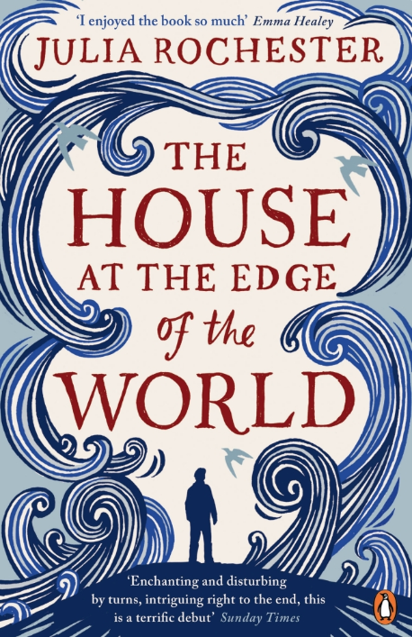
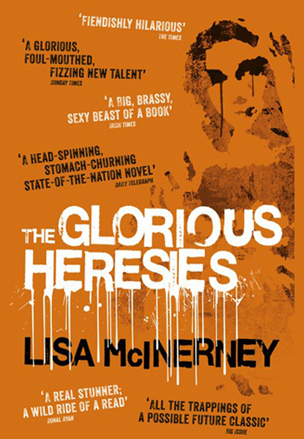
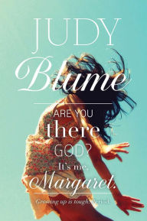
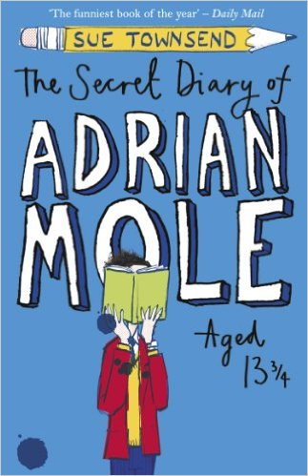
Teacher Reads…
Ms Watt (English)
Last book read: ‘The Glorious Heresies’ by Lisa McInerney
“It won the ‘Bailey’s Women’s Prize for Fiction’ award. It was quite a funny book although I didn’t particularly enjoy the ending. I’m currently reading ‘The House at the Edge of the World’ by Julia Rochester which was also on the BWPFF long list and, in my opinion, it’s much funnier than the winner!”
Favourite books as a Teenager: ‘Are you there God? It’s me, Margaret’ by Judy Blume & ‘The Secret Diary of Adrian Mole’ by Sue Townsend “probably because, like me, they were both bursting with teenage angst!”

Slide 2
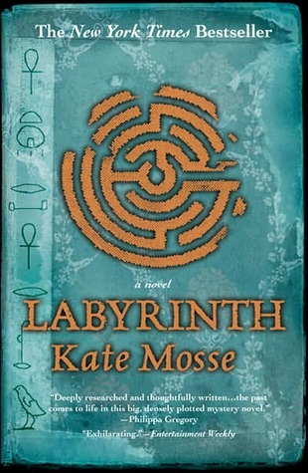
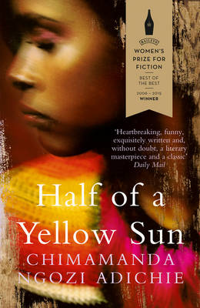
Teacher Reads…
Miss Hunter (Maths)
Last book read: ‘Half of a Yellow Sun’ by Chimamanda Ngozi Adichie
“Having already read ‘Americanah’ and ‘Purple Hibiscus’ by Adichie, I picked up her novel following the lives of people during the Nigerian Civil War in the 60’s/70’s. I enjoyed reading the book, having been oblivious to the events that happened there. Although the book is often ruthless in its description of the brutality of the war, it thoroughly opened my eyes! It has been made into a movie with Chiwetel Ejiofor and Thandie Newton but I haven’t seen it yet!”
Favourite book as a Teenager: ‘Labyrinth’ by Kate Mosse
“My parents got this for me before going on holiday to the Languedoc-Roussillon region in France in which the book was set. I liked learning about the history of the region and cities I was visiting in a far more interesting way! It is currently on my re-read list!”

Slide 3
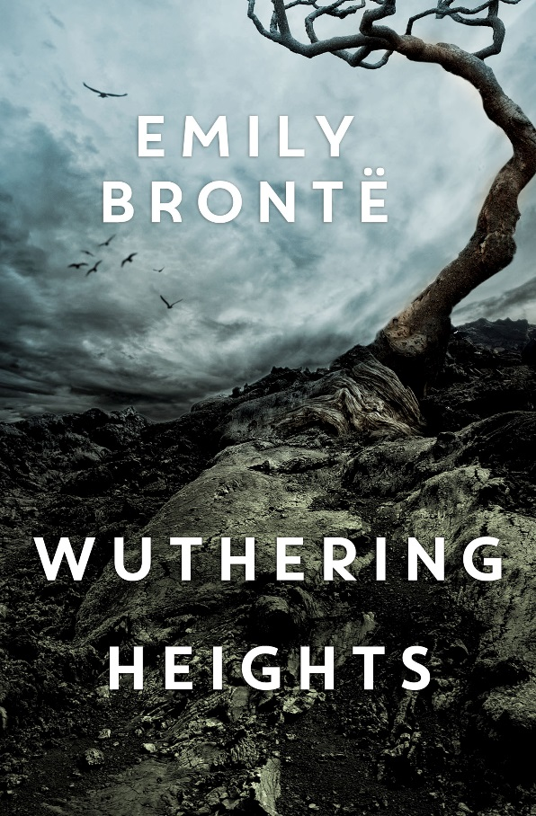
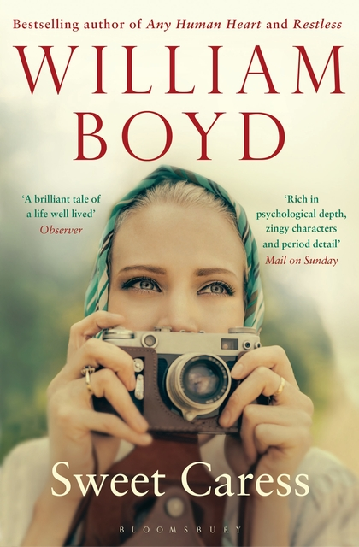
Teacher Reads…
Mrs Todd (ASL)
Last book read: ‘Sweet Caress’ by William Boyd
“Very rich, layered and moving- like many of his novels. I like the way that fate/bad luck/good fortune weave their way through his characters’ lives. The way he portrays the ebb and flow of relationships, and how they can be both inspirational and destructive-sometimes at the same time, seems to resonate with me!”
Favourite book as a Teenager:
‘Wuthering Heights’ by Emily Bronte
“Mainly because the English teacher who introduced it to us played Kate Bush and encouraged us to run around and find our ‘inner Heathcliff’….on reflection, quite revolutionary for a 1980s Scottish classroom!”

Slide 4
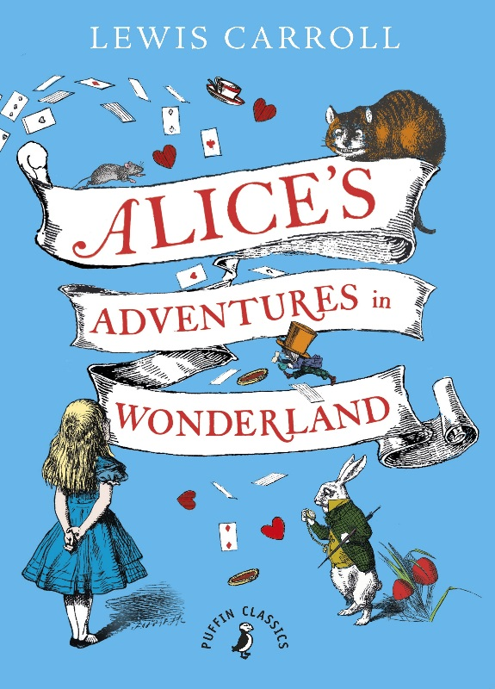
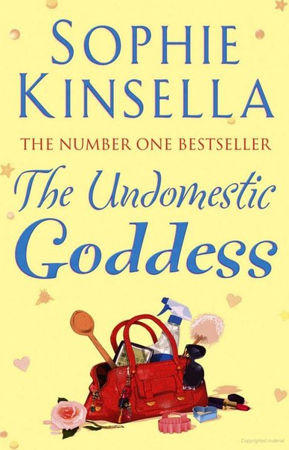
Teacher Reads…
Mrs Paterson (History)
Last book read: ‘The Undomestic Goddess’ by Sophie Kinsella
“I can relate to this book on several levels! I really liked that I could relate to the main character in terms of her lifestyle and work and the overall message young workaholics should take from it.”
Favourite book as a Teenager:
‘Alice’s Adventures in Wonderland’ by Lewis Carroll.
“I loved that in order for the book to come alive you needed to have quite an imagination. I loved the idea of there being a second world you could step in and out of.”

Slide 5
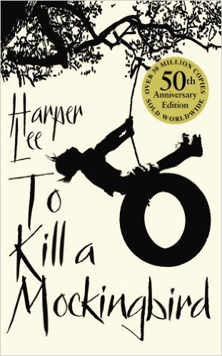
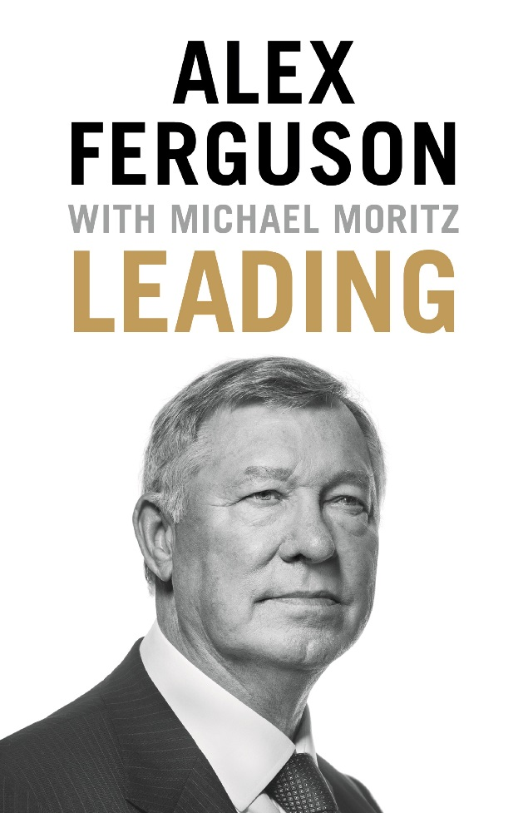
Teacher Reads…
Mr Horberry (Head Teacher)
Last book read: ‘Leading’ by Alex Ferguson
Favourite book as a Teenager:
‘To Kill a Mockingbird’ by Harper Lee.
“Read as a teenager and subsequently read it about 6 times as a great reminder to look at issues and situations from another point of view. Still, the best book, in my opinion, ever written.”

Slide 6
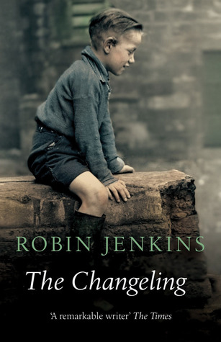
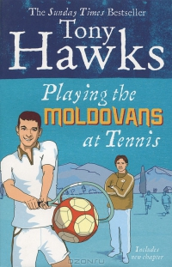
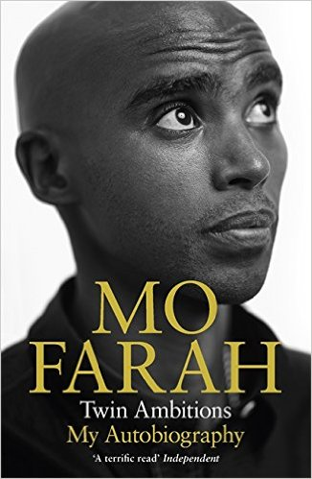
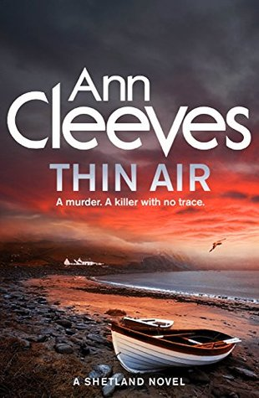
Teacher Reads…
Mr Milne (P.E.)
Last Book Read:
‘Twin Ambitions’
by Mo Farah
“Mo Farah’s autobiography (typical for a PE teacher).”
Currently Reading:
‘Thin Air’ by Ann Cleeves
“I think it was one of the Shetland TV series storylines.”
Favourite book as a Teenager:
‘The Changeling’ by Robin Jenkins
“This was my RPR book for Higher English but I also ended up loving the story
Favourite book ever:
‘Playing the Moldovans at Tennis’ by Tony Hawk
“About a pub bet that ended up with him travelling around Europe, finding and then taking on the Moldovan football team at Tennis (it’s as daft as it sounds but I found it hilarious)!”

Slide 7
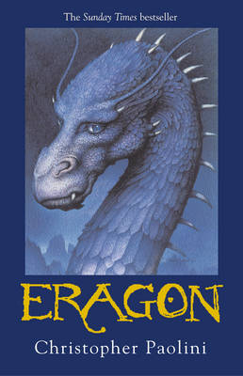
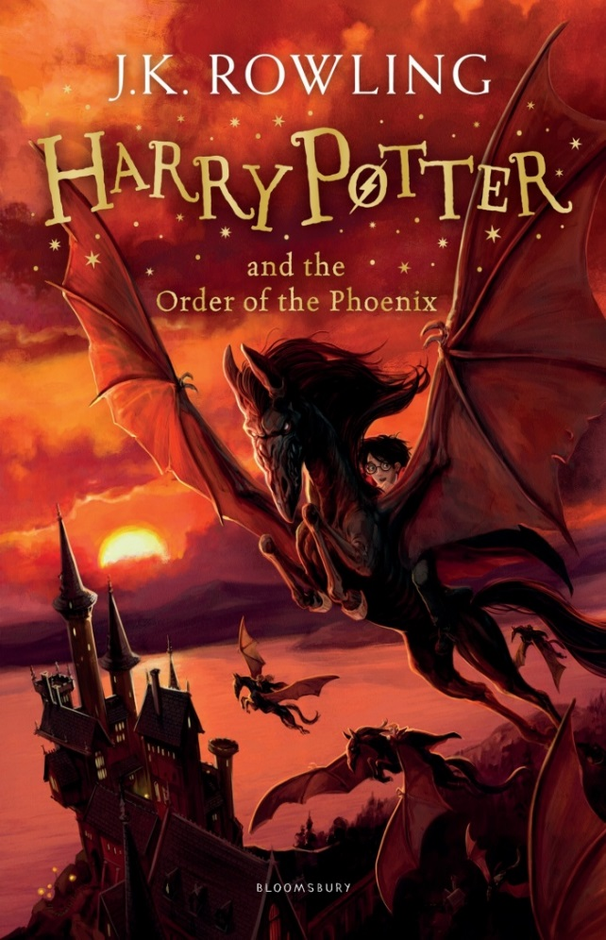
Teacher Reads…
Mr Strachan (Pupil Support)
Recommended Read:
‘Harry Potter and the Order of the Phoenix’ by J.K. Rowling
“Easily one of the most accessible and relatable choices in the series for teenagers at School as it follows Harry’s trials and tribulations going through his 5th Year at Hogwarts School of Witchcraft and Wizardry. Relationship trouble, bullying, overbearing and potentially mentally unstable teachers- what isn’t there to love for our angst-y, hormonal, Nirvana loving cherubs, dealing with the gauntlet that is public school in the North East of Scotland?”
Favourite books as a Teenager: ‘Eragon’ by Christopher Paolini
“Part of the ‘Inheritance’ Series, which is heavily inspired by the works of J.R.R Tolkien, particularly the High Fantasy setting, heavy detail on creating a world and its inhabitants, and an emphasis on storytelling. The story is centred around a teenage boy who discovers a Dragon Egg in the wilderness near his village and goes on an adventure filled with Swords, Sorcery and some interesting twists and turns, all of which will appeal to readers of all ages but is easily accessible to younger readers who struggle to get into reading! Also Dragons are awesome so that alone makes it worth a read.”

Slide 8
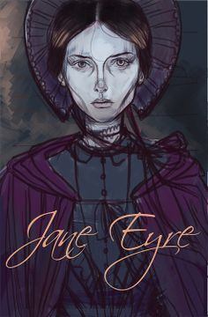
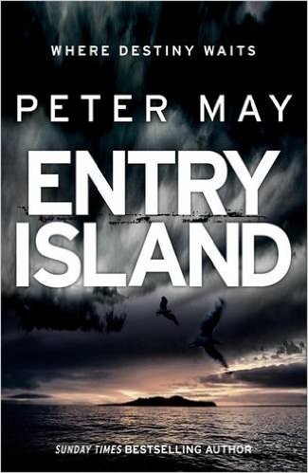
Teacher Reads…
Mrs McKay (English)
Recommended Read:
“I love well-written crime novels like those by Ian Rankin, Stewart MacBride, Val McDiarmid and Denise Mina (who I have just discovered). I have nearly every novel Terry Pratchett ever wrote and also wish that Peter May would complete the final in his ‘Enzo’ series. May’s ‘Entry Island’ is one of my current favourites.”
Favourite books as a Teenager:
“The classics like ‘Jane Eyre’, ‘Wuthering Heights’ and ‘Tess of the D’Urbervilles’. I liked strong characterisation and an ending which satisfyingly completed the main plot.”

Slide 9
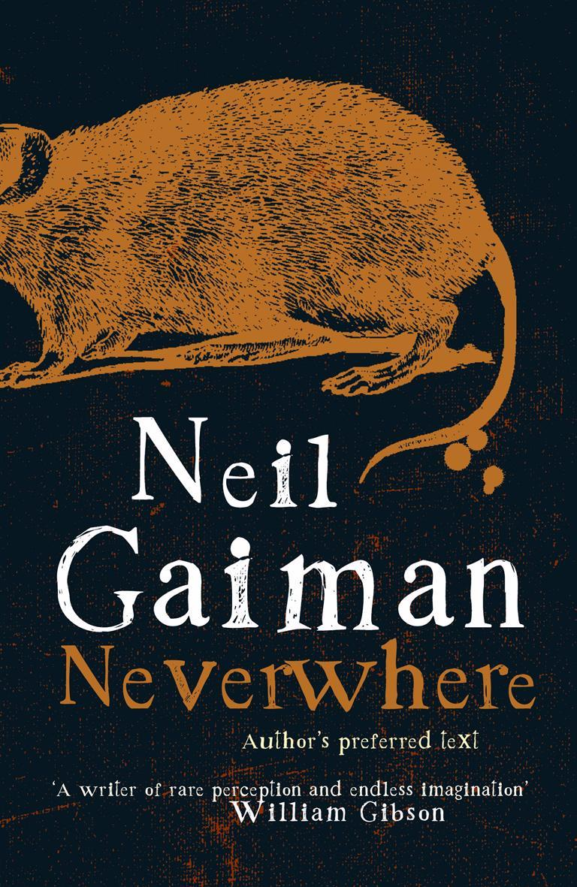
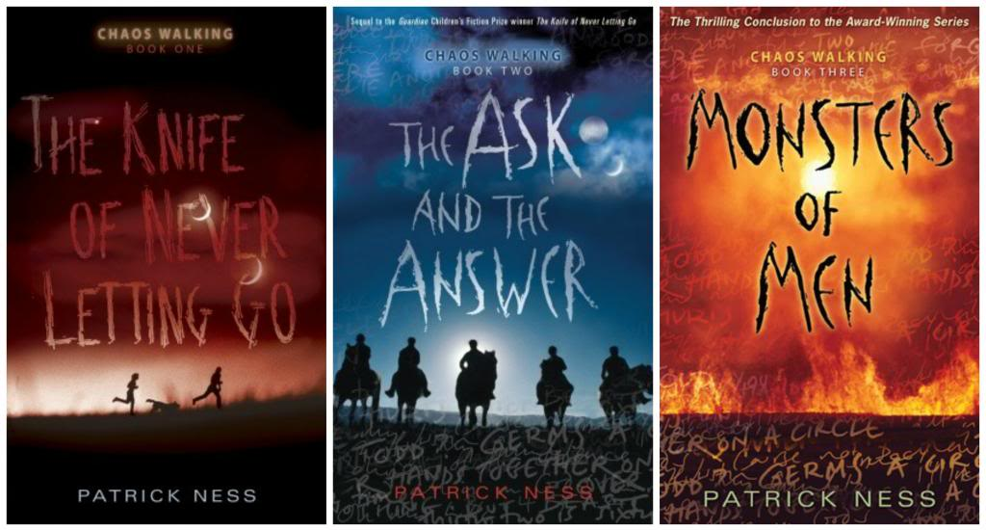
Teacher Reads…
Miss MacFarlane (Biology)
Recommended Read:
“I have just finished reading ‘Neverwhere’ by Neil Gaiman. I really like his books as he is good at taking the normal and day-to-day and making it extra-ordinary. I recently visited London, making this book all the more special as I could visualise the places he was writing about easily.”
Favourite books as a Teenager: ‘Chaos Walking Trilogy’ by Patrick Ness.
“Still my favourite, they are set on another planet with very different natural rules to ours. I like the way that the author narrates this book through his 3 main characters and uses different effects throughout to express the story.”

Slide 10
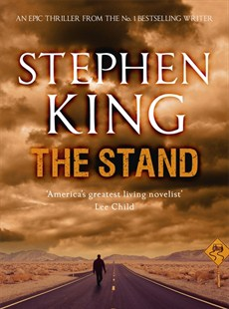
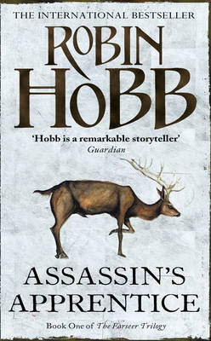
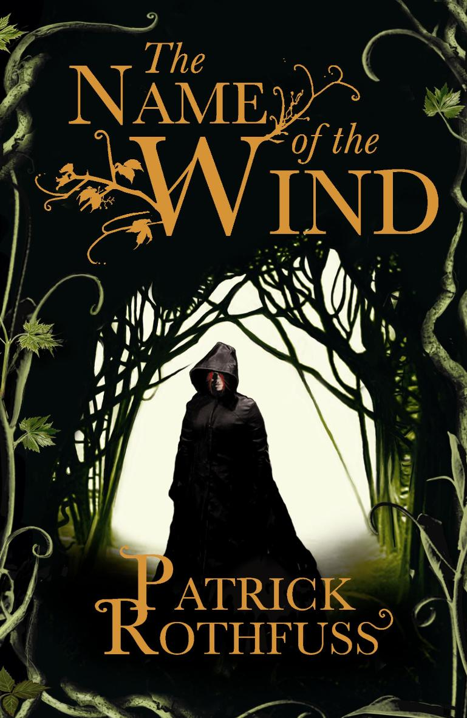
Teacher Reads…
Mr Bappoo (Physics)
Currently Reading:
‘The Stand’ by Stephen King
“At 1,152 pages it is going to take a while.”
Recommended Read:
‘The Name of the Wind’ and ‘The Wise Man’s Fear’ by Patrick Rothfuss. Also ‘Mistborn’ series by Brandon Sanderson. I read mostly Fantasy and some Sci-Fi.”
Favourite books as a Teenager:
“As a teenager I read more widely from Jack London to Jules Verne. But continuing on the fantasy theme one of my favourite books is ‘Assassin’s Apprentice’ by Robin Hobb.
I liked the setting and writing. A gripping storyline which quickly draws you in is the best thing about the book. It keeps you reading.”

Slide 11
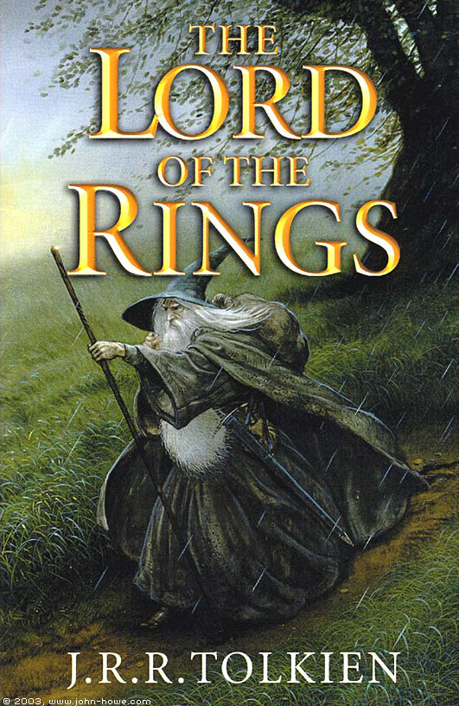
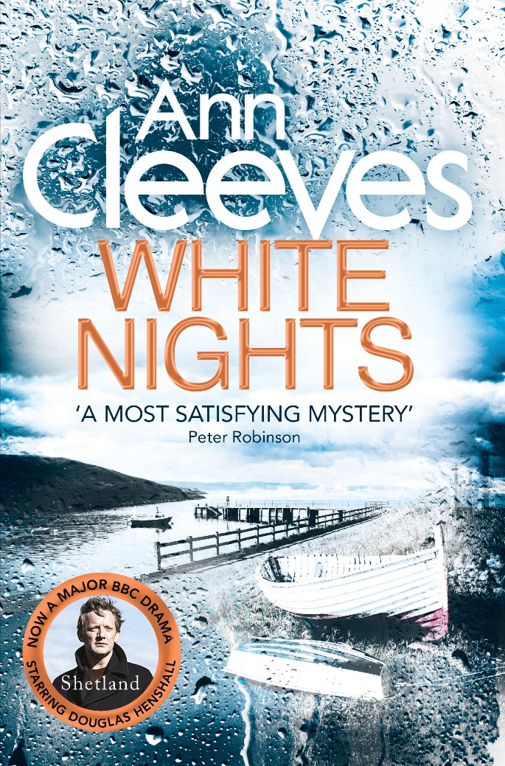
Teacher Reads…
Mrs Murray (Business)
Currently Reading: ‘One Man Crusade’ by Steven Suttie
“It is not as compelling as some of the detective novels I have read, but good nevertheless. Set in Manchester it would appear that there is a serial killer who is ‘exterminating’ convicted paedophiles . Only just into the book (16%). I do read a lot of this type of book and love the Shetland series by Ann Cleeves.”
Favourite books as a Teenager:
“I read a huge number of Dick Francis, Mary Stewart and Wilbur Smith. Didn’t get into Lord of the Rings until I was 18.”

Slide 12
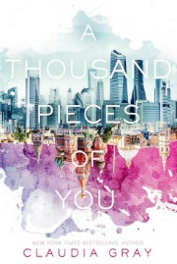
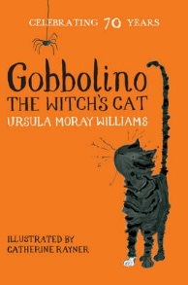
Teacher Reads…
Mrs Howitt (Computing)
Currently Reading:
‘A Thousand Pieces of You’ by Claudia Gray
“It’s about a girl chasing her father’s murderer through different dimensions. I’m not too far into the book but it’s definitely got my interest so far!”
Favourite book as a Child:
‘Gobbolino the Witches Cat’ by Ursula Moray Williams.
“I’m not sure why I enjoyed the book so much but probably it was to do with the cat being different and just trying to find someone who wanted him for him and not because he conformed to how a witches cat should be.”

Slide 13
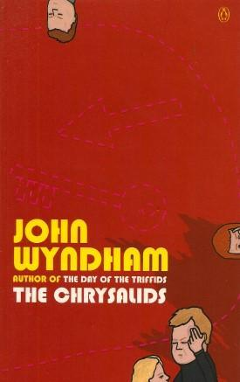
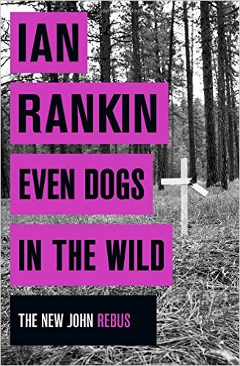
Teacher Reads…
Mrs Tait (Maths)
Currently Reading:
“I have just finished reading Ian Rankin ‘Even Dogs in the Wild’. I am a fan of the series and look forward to getting the latest one ‘Rather be the Devil’ for Christmas. Rankin manages to write a gripping crime story without having to be extreme and graphic on violent or sexual detail which puts me off some other crime series.”
Favourite books as a Teenager:
“As a teenager I read a lot of Science Fiction and particularly liked John Wyndham. His stories, managed to convince me that such things as Triffids, Midwich cuckoos etc were just possible. My favourite was probably ‘The Chrysalids’. Believable and scary.”

Slide 14
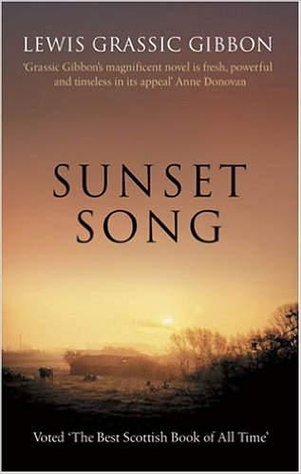
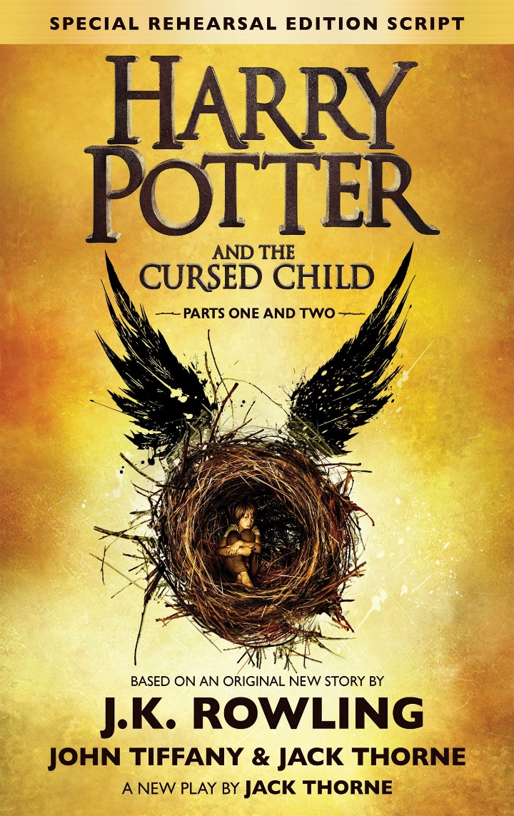
Teacher Reads…
Mrs Smith (ASL)
Last Book Read:
’Harry Potter and the Cursed Child’ by J.K. Rowling
“I have never read screen-plays before but thoroughly enjoyed this, very fast-paced page turner.”
Favourite book as a Teenager:
‘Sunset Song’ by Lewis Grassic Gibbon
“Read and enjoyed as part of a school project. I attended a performance in our local theatre at the time. It interested me as the story was set in our neck of the woods.”

Slide 15
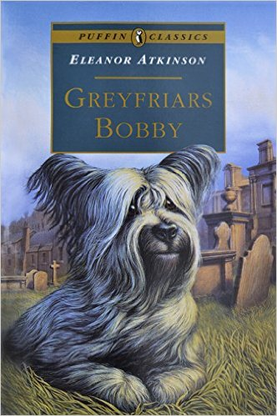
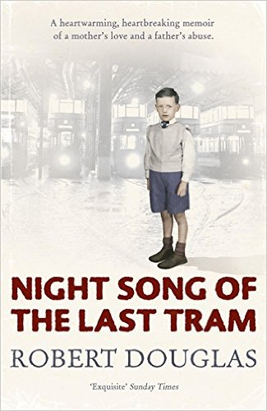
Teacher Reads…
Mrs Bishop (Technician)
Last Book Read:
‘Night Song of the Last Tram’ by Robert Douglas
“An autobiographical account of a young boys life growing up in 1940s Glasgow. It transported me back in time and was both joyous and sad in equal measure. The vivid and evocative picture painted of tenement life for this little boy beautifully describes the sense of community and family at that time. The war and how it affected all aspects of life seems almost unbelievable to us now but these folk lived through it and emerged stronger for the experience. After reading this book my respect for the generations who were forced to live through war time was reinforced and I was genuinely moved by this account of the times.”
Favourite book:
‘Greyfriars Bobby’ by Eleanor Atkinson
“I have returned to this book many times over the years as the story is just so inspiring. I have always had a deep affinity with animals so the real life story of a wee dog remaining faithful to his dead master by laying on his grave in often extreme weather conditions is truly moving. I think Bobby’s story will always appeal to people because the characteristics he displayed of love and devotion are perhaps sadly rare but much admired in a civilised society.”

Slide 16
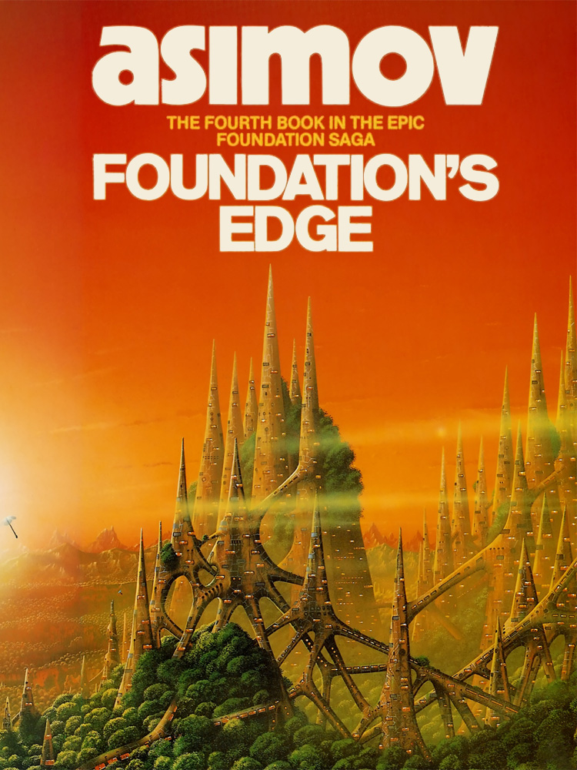
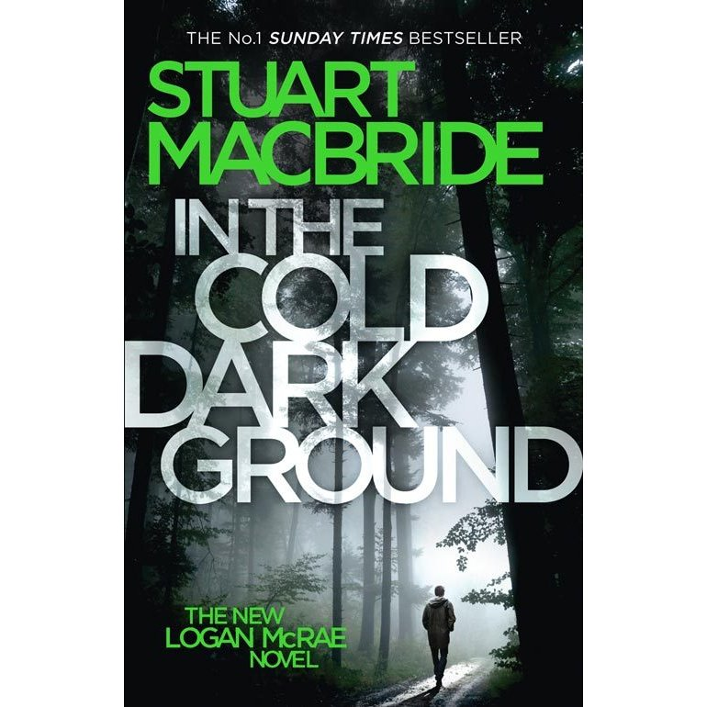
Teacher Reads…
Mrs Farquhar (Maths)
Currently Reading:
‘In the Cold Dark Ground’ by Stuart MacBride
“I am particularly enjoying it because it is set in the local area around Banff/Portsoy/Aberdeen etc. Also the main character is Logan McRae who has appeared in 11 other books by the same author. I have read most of them and so I feel I know the character well. Logan McRae is a policeman and I generally enjoy detective novels.”
Favourite books as a Teenager:
‘Foundation's Edge’ by Isaac Asimov
“As a teenager, I read a lot of Science Fiction. I found it interesting what the world of the future was imagined to be like. Also I liked the fact that Isaac Asimov was a scientist as well as a writer. He made up the 3 laws of robotics and wrote many stories featuring robots.”

Slide 17
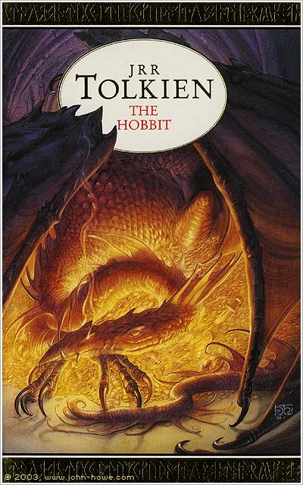
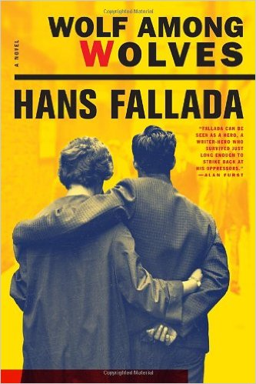
Teacher Reads…
Mr Neilson (P.E.)
Currently Reading:
‘Wolf among Wolves’ by Hans Fallada
“I love Berlin and am fascinated/ horrified by the Hitler/ Nazi persecution of ALL people.”
Favourite books as a Teenager:
‘The Hobbit’ by J.R.R. Tolkien
“Just loved the Fantasy, love the films and the trilogy of Lord of the Rings.”

Slide 18
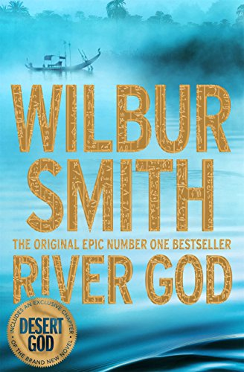
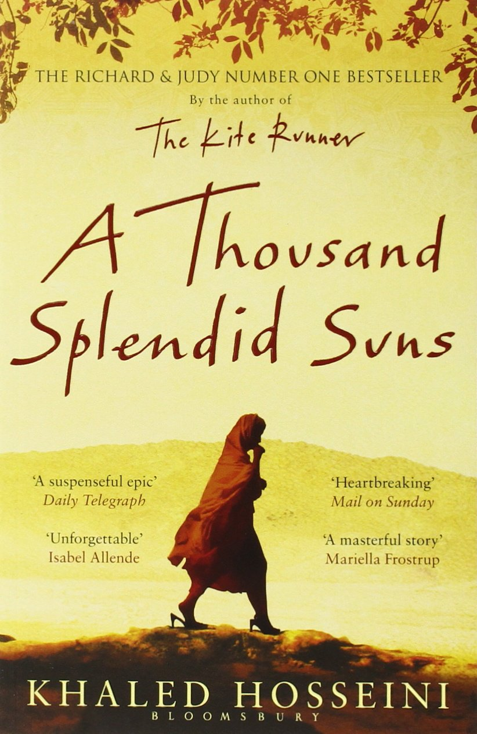
Teacher Reads…
Ms Owen (Biology)
Favourite Read ever:
‘A Thousand Splendid Suns’ by Khaled Hosseini
“I grew up in the Middle East and I worked out there for five years. I just love that part of the world; the people, the landscape and the culture. I am sure I will return again to it at some point. I am acutely aware of the issues women can face living within a very conservative society, and how growing up there is so very different to our upbringing here. Khaled Hosseini writes about these issues, and about human emotions, so beautifully. I remember being haunted by ‘A Thousand Splendid Suns’ for weeks after I had finished reading it.”
Favourite books as a Teenager:
“I actually read quite a lot of the children’s classics as a teenager; ‘Black Beauty’, ‘Swiss Family Robinson’ and ‘Alice In Wonderland’ to name a few. I can remember writing about ‘River God’ by Wilbur Smith for my RPR in Higher English. I’ve always loved Ancient Egypt and it’s an adventure story set there. It remains one of my favourite books to this day!”

Slide 19
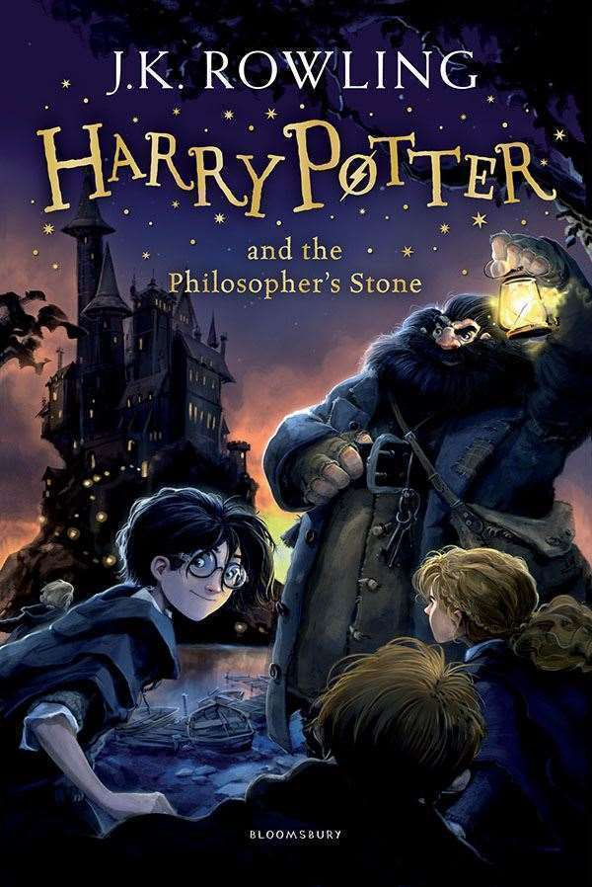
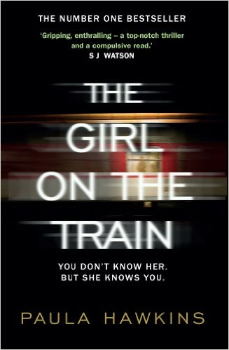
Teacher Reads…
Miss McClelland (English)
Favourite recent Read:
‘The Girl on the Train’ by Paula Hawkins
“I love reading, but with the time pressures of teaching I don’t get to read as much as I’d like to any more. I read this a few months ago and LOVED it. I couldn’t put it down, so much so that I started and finished it in one day. I couldn’t allow myself to go to sleep until I knew what happened!”
Favourite books as a Teenager:
‘Harry Potter’ series by J.K. Rowling
“I grew up with them and adored them. I could still repeatedly read them and never get bored. I read the new book over the summer,
‘Harry Potter and the Cursed Child’. I really enjoyed it as it transported me back to my childhood with all the ‘Harry Potter’ memories. Again, I read that in one weekend because I was so enthralled. I also really love ‘To Kill a Mockingbird’. I studied it at school and fell in love with it. It’s a book I would love to teach.”

Slide 20
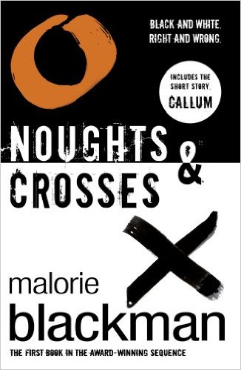
Teacher Reads…
Miss Anderson (Geography)
Last Book Read:
‘The Girl on the Train’ by Paula Hawkins
“This book was very gripping and fast paced I couldn’t put it down. Overall fantastic book.”
Favourite book as a Teenager:
‘Noughts & Crosses’ by Malorie Blackman
“I found this book (and series) incredibly interesting, the way the author explores themes of racism and changes our perceptions of race too. This is a book which has resonated with me into my adult life.”

Slide 21
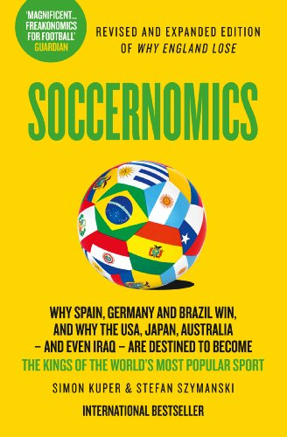
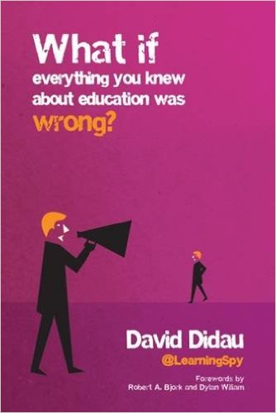
Teacher Reads…
Mr Mochan (P.E.)
Currently Reading:
‘What if everything you knew about education
was wrong?’
by David Didau
Favourite book as a Teenager:
‘Soccernomics’ by Simon Kuper & Stefan Szymanski
“I enjoyed this book as it combined stats and figures with my favourite sport football, for example statistically speaking it is the best option to place a penalty straight down the middle as this will having the greatest chance of scoring.”

Slide 22
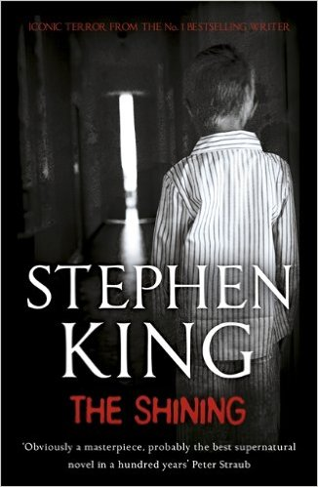
Teacher Reads…
Miss Brown (Chemistry)
Recent Reads:
‘The Cold Dark Ground’ by Stuart McBride
“I have also just finished ‘The Girl on the Train’ by Paula Hawkins. ‘Hostile Habitats’ would be a factual book read last year, had to read it to swot up for my ML. Adults have to learn and revise too!”
Favourite books as a Teenager:
“Stephen King and Wilbur Smith, take your pick from their books, have read most of them. Why? Imagination, the ability to paint pictures with words and you can let your imagination do the rest.”

Slide 23
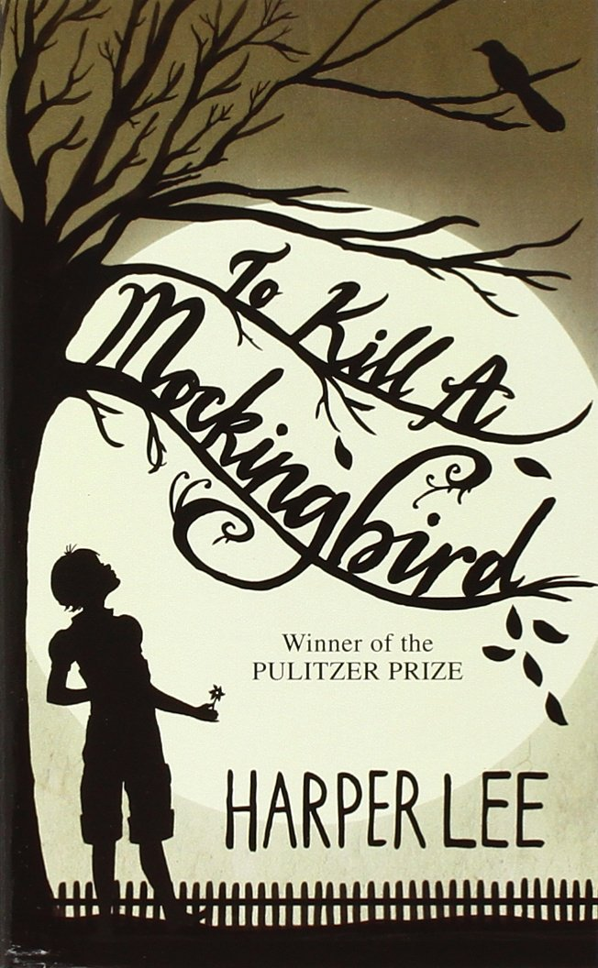
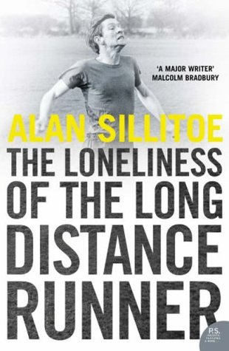
Teacher Reads…
Dr McCabe (Guidance)
Last Book Read:
‘The Loneliness of the Long Distance Runner’ by Alan Sillitoe
“I was given this for my birthday in September because I am a long distance runner and I also love the film. I enjoyed the book because it was written in such a way I felt I had an insight inside the main character’s head and it gave analyses of a disillusioned Northern working class boy who spent a lot of time thinking as he ran, that rang true.”
Favourite book as a Teenager:
“I first read ‘To Kill a Mockingbird’ by Harper Lee when I was 9, the same age as one of the characters in the book. I have read this book approximately every eighteen months ever since. I realised a few years ago the part of the reason the town is so real in my mind is because the map of the town I made in my mind mirrored the actual map of the town I grew up in. Each time I have read the book I find a different emphasis, for example as a child I focussed on the spooky parts of the story, now I read it from a parent’s point of view. I always cry in the same places.”

Slide 24
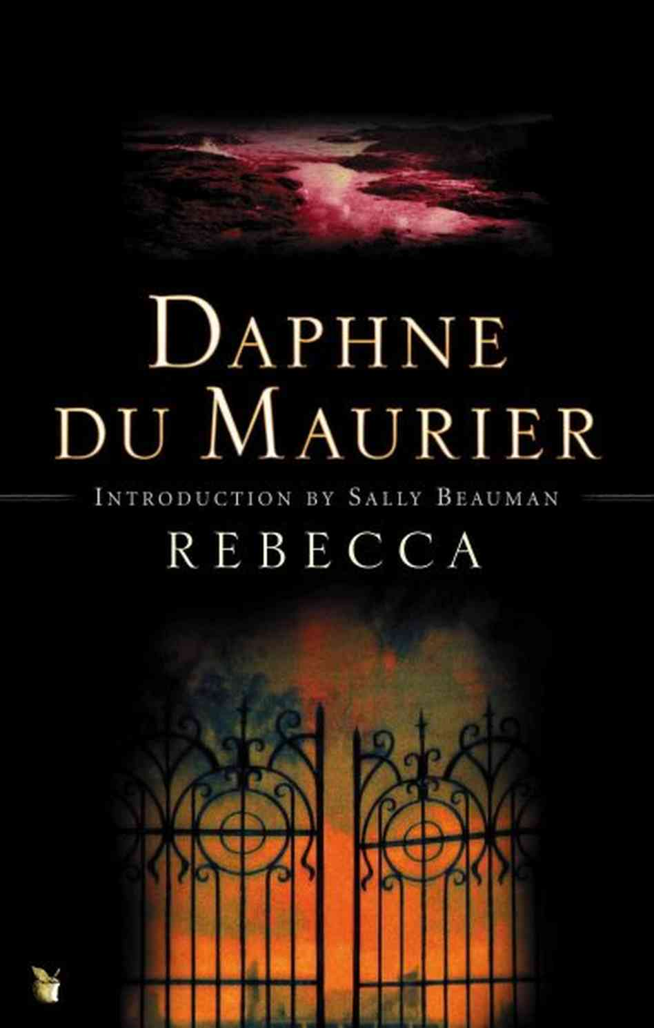
Teacher Reads…
Ms Chalmers (ASL)
Last Book Read:
‘My Name is Lucy Barton’ by Elizabeth Strout
“Lucy is in hospital a long way away from her husband and children. During the enforced bed rest, she is visited by her mother with whom she has had a strange and distant relationship. The book explores the mother-daughter relationship, Lucy’s uneasy relationship with her husband and her reminiscences of her impoverished childhood. The reader is left feeling concerned and uncertain about what happened in Lucy’s past and also about what will happen in her future.”
Favourite book as a Teenager:
‘Rebecca’ by Daphne Du Maurier
“The narrator is young, desperately shy and feels inadequate to the task of being a wife to the suave and sophisticated Max de Winter. Gradually, the book reveals the story of his first marriage to glamorous and confident Rebecca, a character who could not be more dissimilar to the timid narrator. I enjoyed this book as a ghost story, a murder mystery and a study of shyness and girlish angst.”

Slide 25
Teacher Reads…
Mrs Clarke (Guidance)
Currently Reading:
“I have had an aim to read a book before going to see the film at the cinema, my last two efforts were thwarted due to me being such a softie. I read ‘Marley & Me’ by John Grogan and ‘War Horse’ by Michael Morpurgo both books reduced me to tears so there is no way I could cope with the film.
Hopefully third time lucky, this time I have chosen to read
‘The Girl on the Train’ by Paula Hawkins. Haven’t quite finished it yet but I can’t wait to find out ‘who done it’ and then hope to go and watch it.”
Favourite book as a Child:
‘The Sheep Pig’ by Dick King-Smith

Slide 26
Teacher Reads…
Miss Newbould (ASL)
Currently Reading:
Me Before You by Jojo Moyes
“Enjoying it so far but I can see the sad ending looming.”
Favourite book as a Teenager:
“I was into all the Ian Rankin ‘Rebus’ books, just because I went to Uni in Edinburgh so knew all the places, that and I love a good murder mystery. I like Ian Rankin’s style of writing too, especially his characters.”

