Slide 1
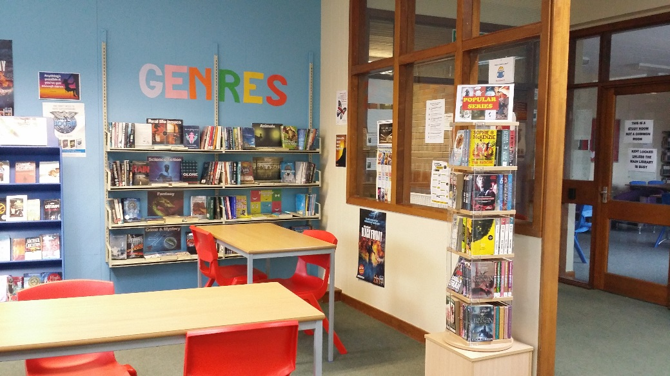
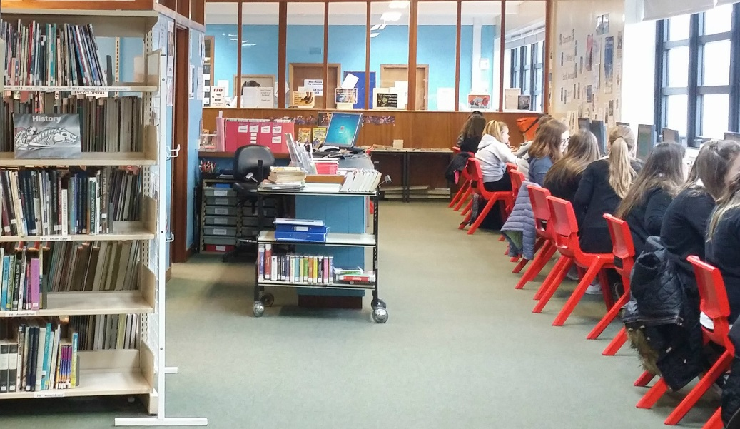
LIBRARY REFRESHER
ONLINE RESOURCES
VOLUNTEERING
READING
RESEARCH SKILLS

Slide 2
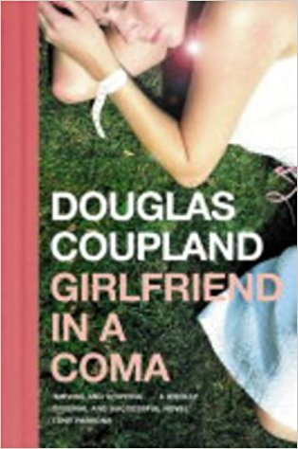

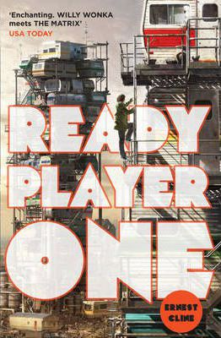



Network Librarian- Mr Henderson
Manage Banff Area Libraries
Supporting the Curriculum
Reading Promotion
Library Assistants
Shirley Adie- Mon-Thu 10-1
Marjory Nicholson- Friday 10-1

Slide 3
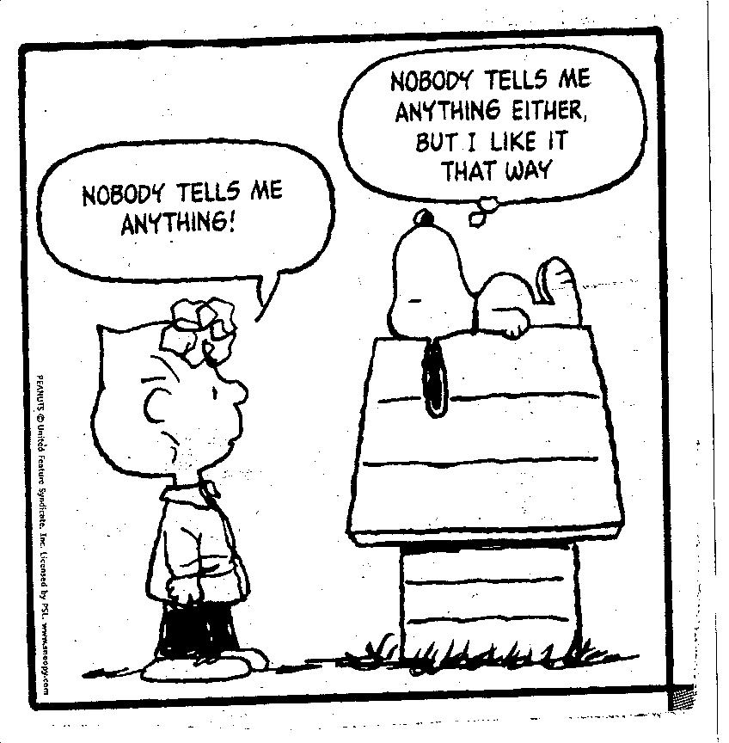
What is the Library for?
Borrowing
Computers
Printing
Reading
School work
Board games
Quiet time!
Notes:
Books, Magazines, Study Guides, Audiobooks
Print responsibly: 1 copy, limited number of images, A4 formatting.

Slide 4

Borrowing
Six books for one month
Need longer? Bring it back and it can be extended for another month.
Choose a book to borrow
Hand the book to the librarian
Librarian will issue the book/ stamp it with a return date
DO NOT walk out with the book without it being issued!
Notes:
Very simple process

Slide 5

Fiction
Author surname A-Z
Novels
Quick Reads
Comics (incl. Manga)
Audiobooks
Notes:
Not Fact/ ‘Made up stories’
‘Junior’ and ‘Senior’ Fiction Sections
Alphabetical by Surname, A-Z
‘Quick Read’, ‘Graphic Novels’ and ‘Non-English’ sections
Accelerated Readers, coloured dots on the spines
Genre labels on the spines

Slide 6
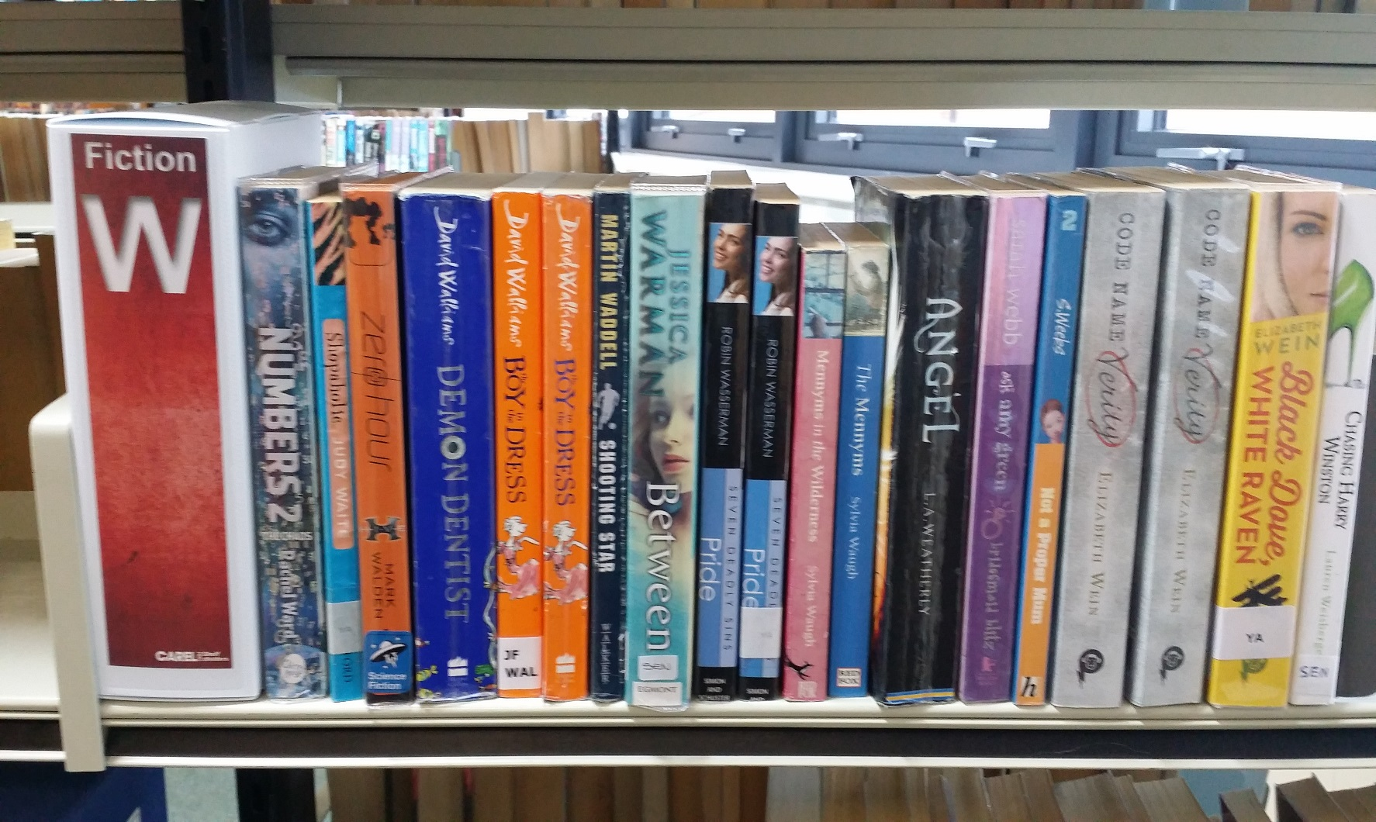
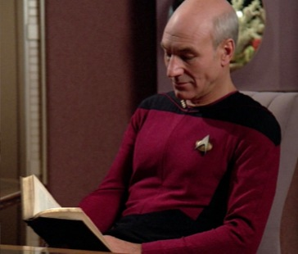
Fiction
JF
WAL
TF
WEI
SF
ZOL

Slide 7
ACCELERATED READER
LEVELS
1
3
5
2
4
Notes:
Reading scheme used to guide junior pupils in their reading- colours indicate difficulty level of the text (note: not a reflection of content/ topic or ‘interest level’)

Slide 8
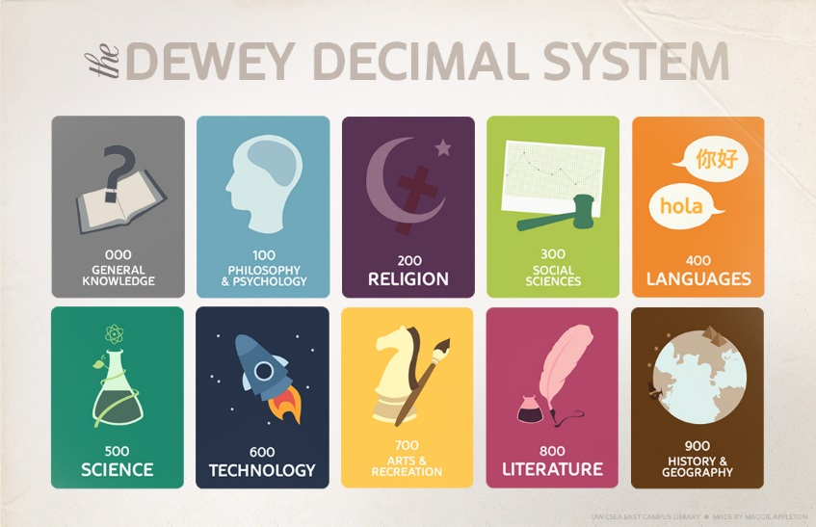
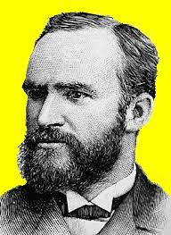
Non-Fiction
Scottish/ Local
Biography
Careers
Further Educati
Issues
Study Guides
Past Papers
Teacher resources
Reference
Magazines
Newspapers
Notes:
Formats of physical materials: Books / Journals/ Newspapers
Layout
Non-Fiction or Factual books, organised by subject in Libraries
Dewey/ Subject headings
Contents (listing of contents by chapter and section with page numbers)
Index (alphabetical listings of each name and item with page numbers at the back of the book)
Melvil Dewey- inventor of the Dewey Decimal Classification system (used in many school, public, college, University, corporate and public libraries).

Slide 9
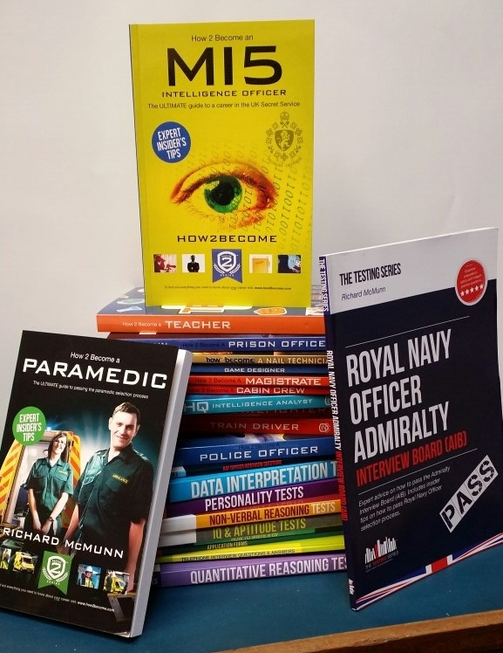
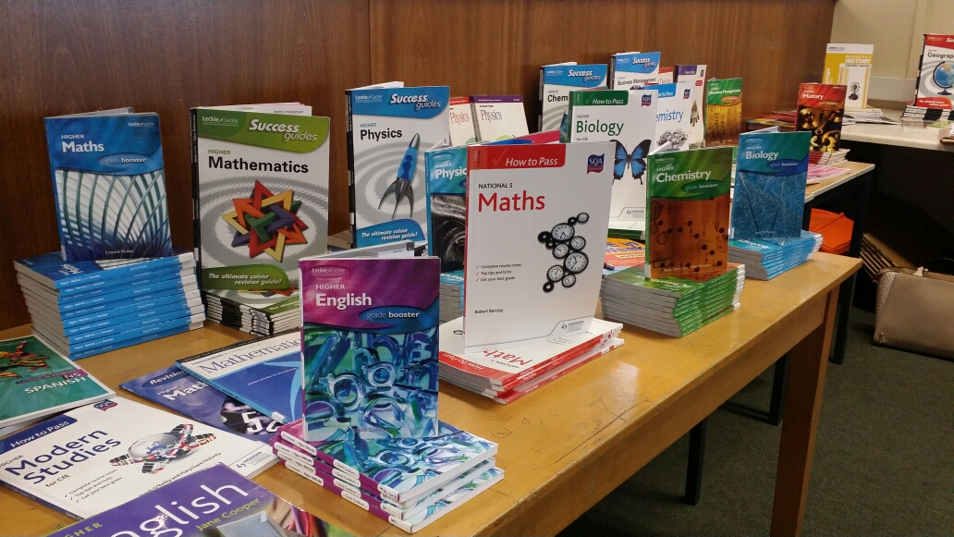

Slide 10
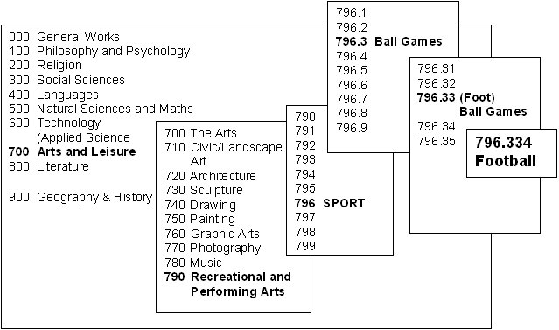

Slide 11
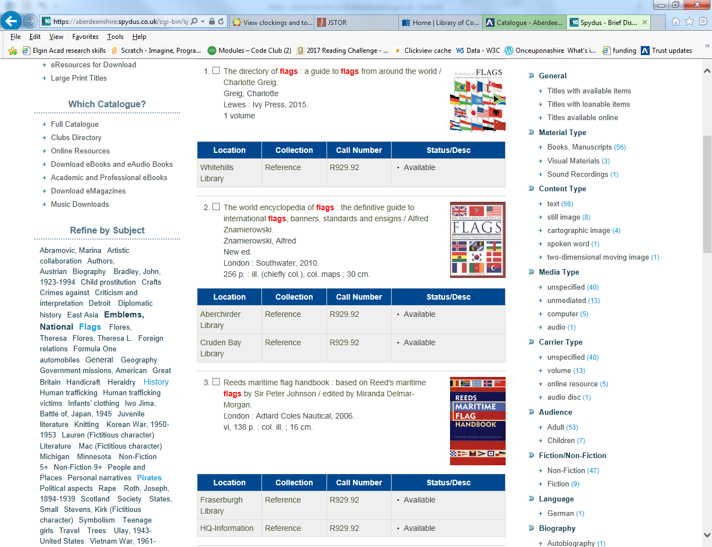
Finding a Non-Fiction book:
Go to the SUBJECT INDEX (Subjects in alphabetical order) or the Catalogue homepage
What subject are you looking for?
FLAGS
Each subject has a DEWEY NUMBER:
Flags 929.92 Flies 595.77
Flight 387.7
Now go to the Non-Fiction
section of the library and look for a book with the number 929.92 (There may be more than one!)
Find your Dewey Number:
FLAGS
929.9
Notes:
You may have to search in books about broader subjects to find the specific information you require.
For example, if you can’t find a book about RABBITS you might find information in a book about PETS 636.088 or ANIMALS 599. Check the index at the back of the book to see if ‘rabbits’ are listed. If not, try another book at the same number.
If you are looking for DAFFODILS there may not be an entry in the Subject Index for this and you then have to look at the broader subject. In this case it would be FLOWERS 635.9. Again, check the index at the back of the book to see if Daffodils are listed. If not, try another book at the same number.

Slide 12
Who wrote it? Is it accurate?
Is it Biased? Is it useful?
Video
Notes:
‘Is it biased?’ link to ‘Alternative facts’
Not all sources are good quality sources
When you are using a new source to find information, you should always ask yourself these questions.
Who wrote it?
Are they an expert? Qualifications?
What is their association with the subject?
Are contact details obvious? (can be an individual, company, school, government agency, non-profit organization)
Is it accurate?
Does the information ‘fit’ with what you already know? Can it be verified in other sources?
How up to date is the material? Last edit date? Any dead links?
Do the ‘facts’ check out?
Are there references or links to more information? (essential for Wikipedia use)
Is the website well-researched and information/ stats properly cited?
Is the page well-written and organized? (no obvious grammar or spelling errors)
Is it biased?
Some sources of information are purely factual- these are mainly encyclopaedias, dictionaries, reference works
Is there likely to be bias? (Is this the site of a company selling products or an individual/organization with a specific agenda?)
Most sources contain an element of opinion or bias- the writer’s point-of-view on the topic
Is it useful?
The website may be cool but is the information relevant or related to the topic you are investigating? Does it really answer your research question?
Is the source laid out so that you can find information easily?
Can you understand the vocabulary in the source without too much difficulty? (you may have come across material written only for experts in the field or vice versa, aimed at Primary school level- too basic)

Slide 13


ONLINE RESOURCES

Slide 14
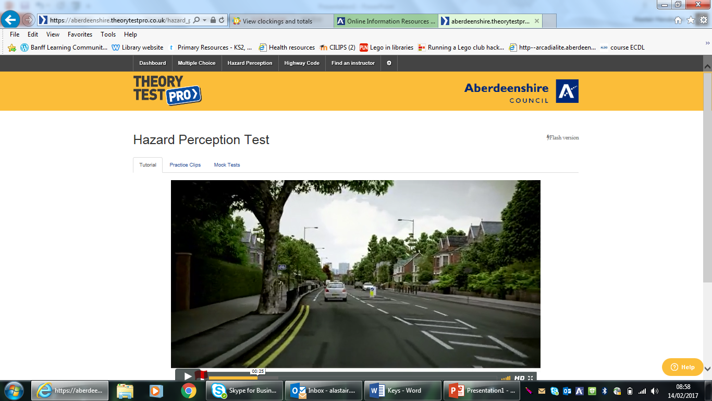

Slide 15
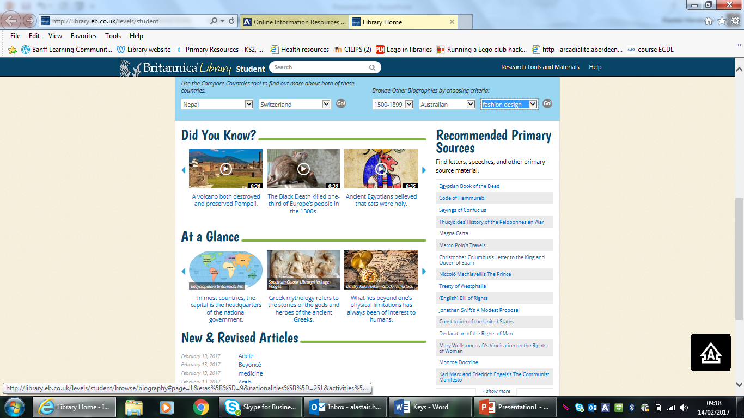

Slide 16
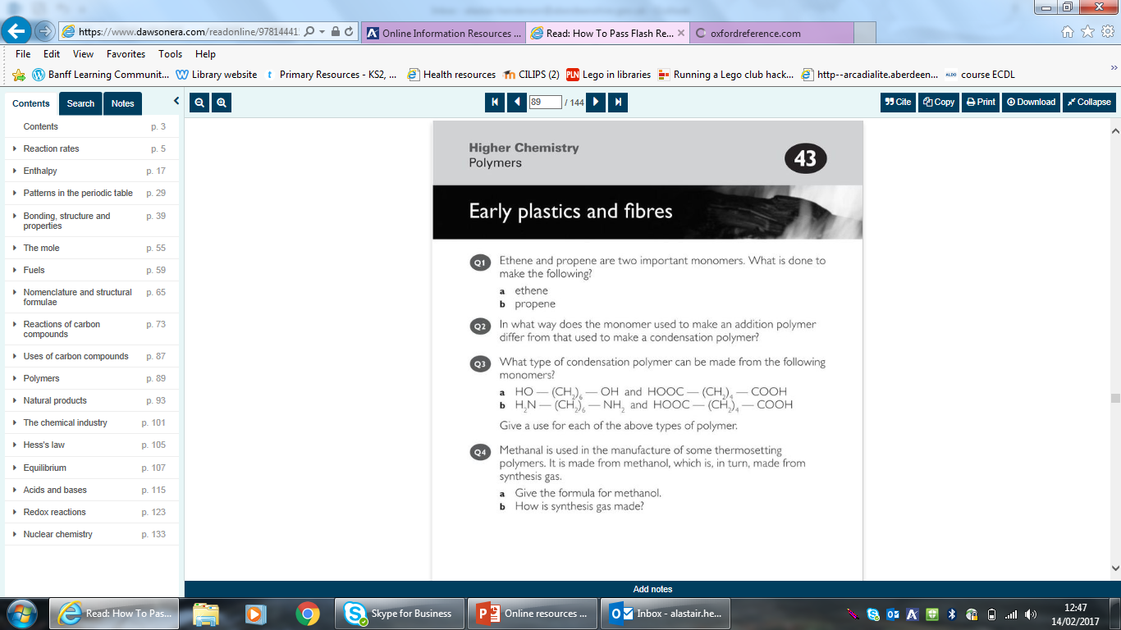

Slide 17
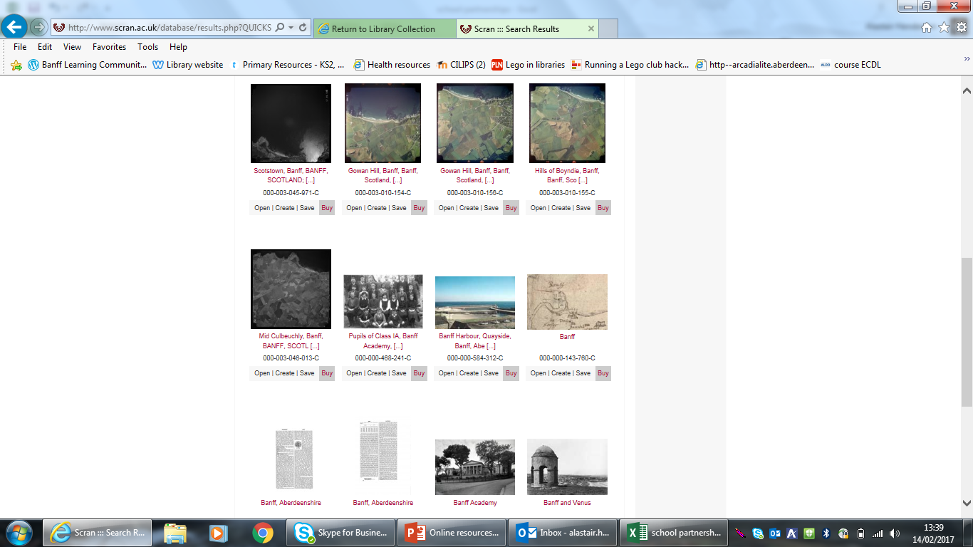


Slide 18
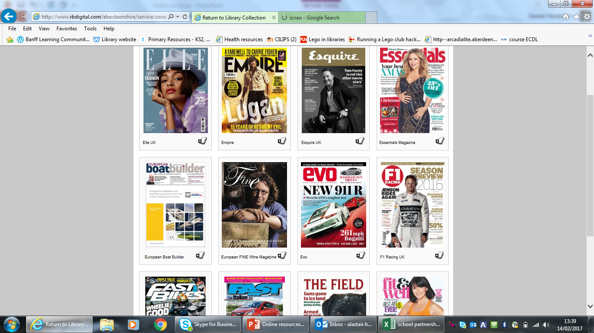

Slide 19
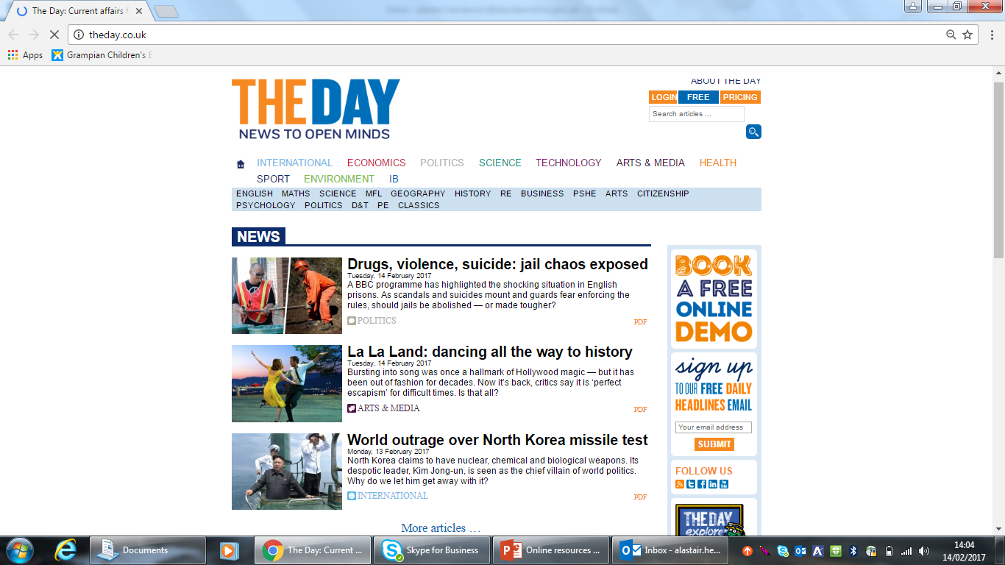
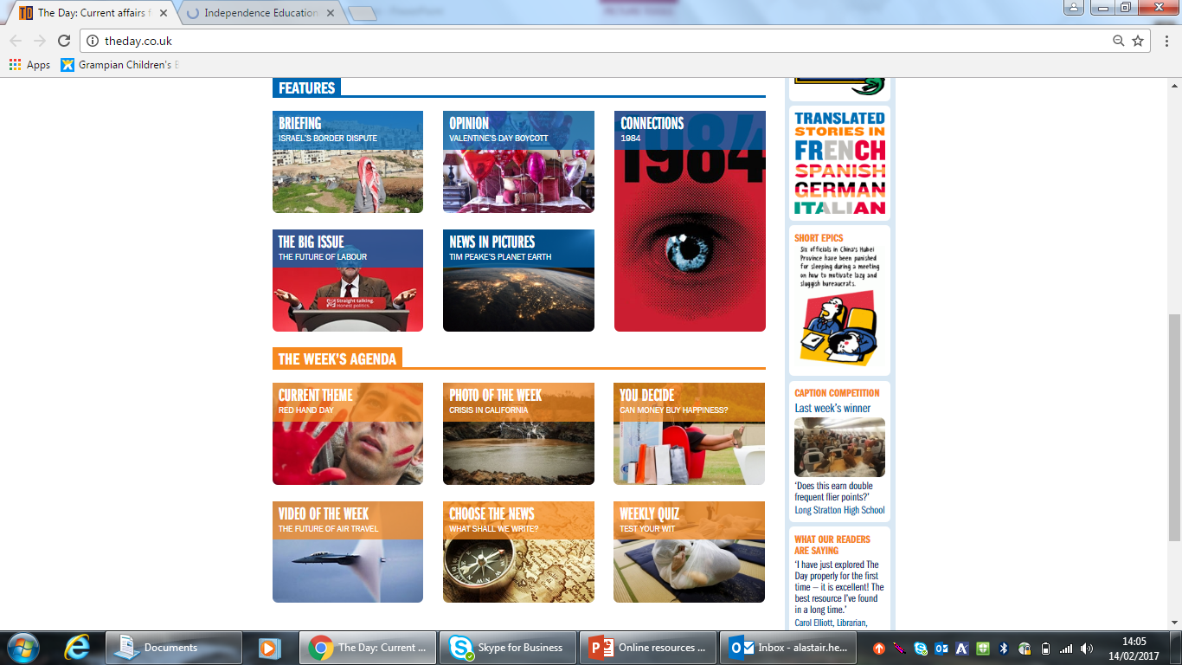
THE DAY

Slide 20
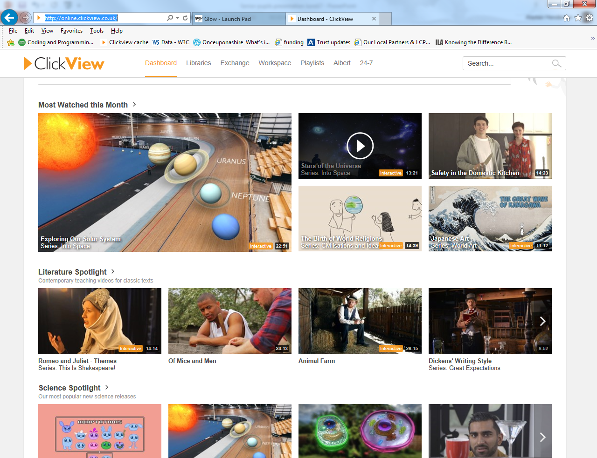
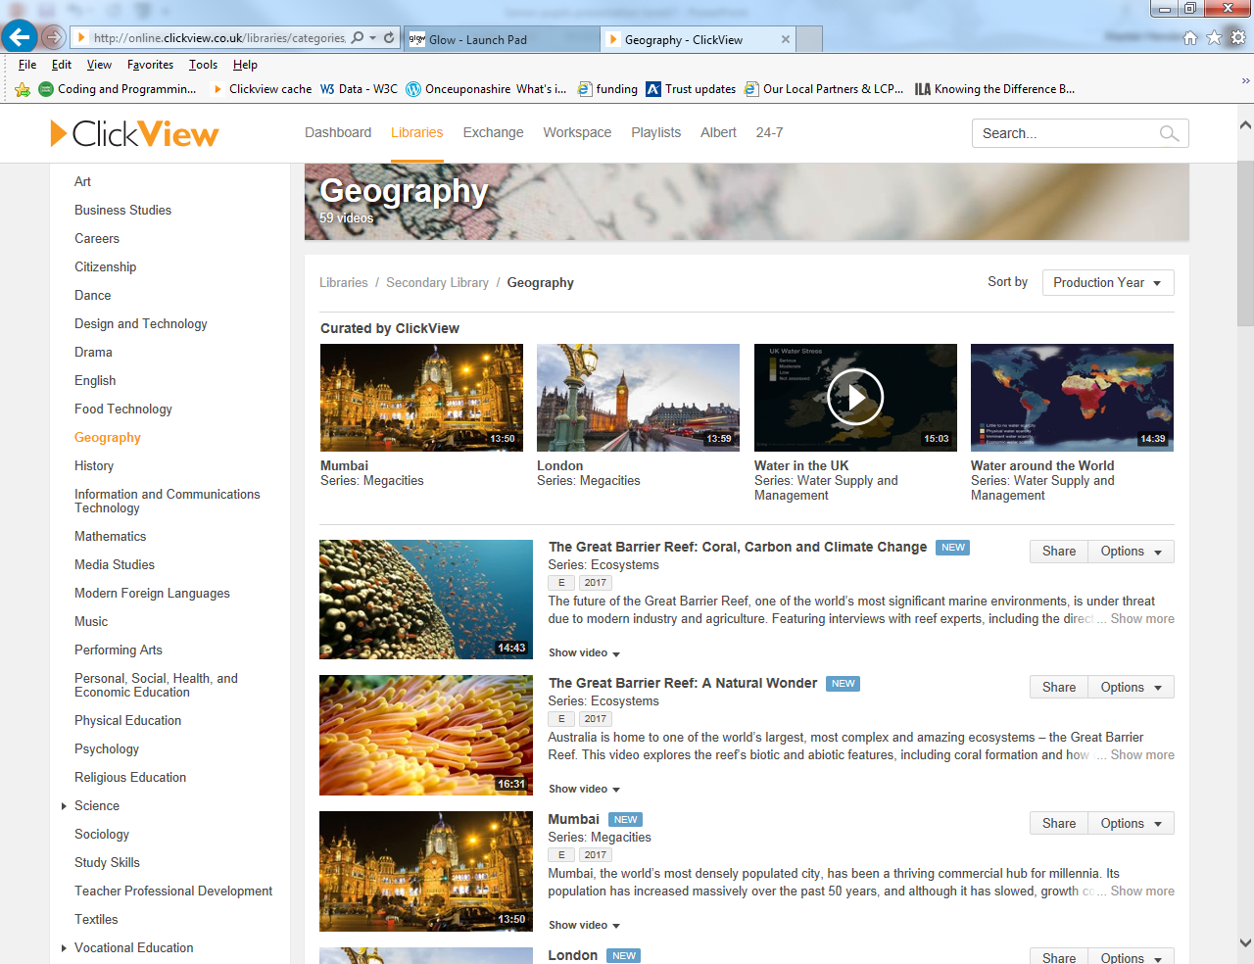

Slide 21
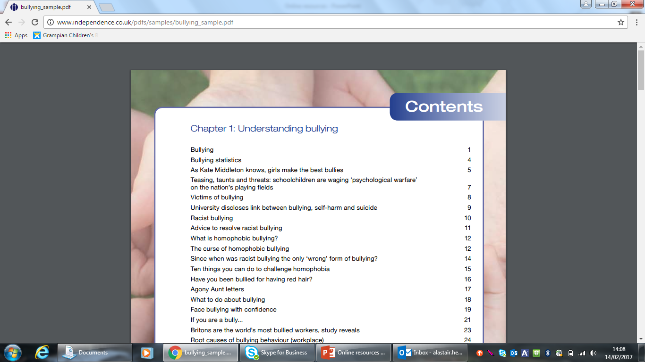

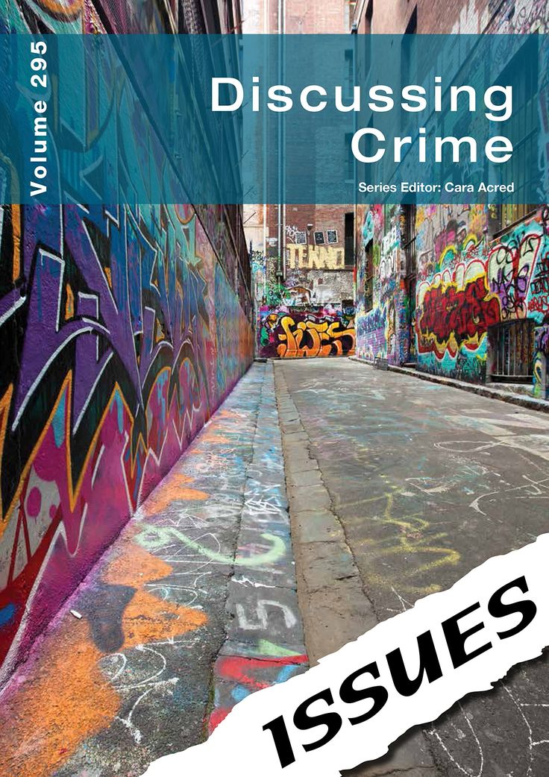

Slide 22
Volunteering
What?
Teaching ICT skills
Paired Reading/ AR Buddies
Libraries
For?
DoE
Saltire Award
Uni Statement
CV

Slide 23
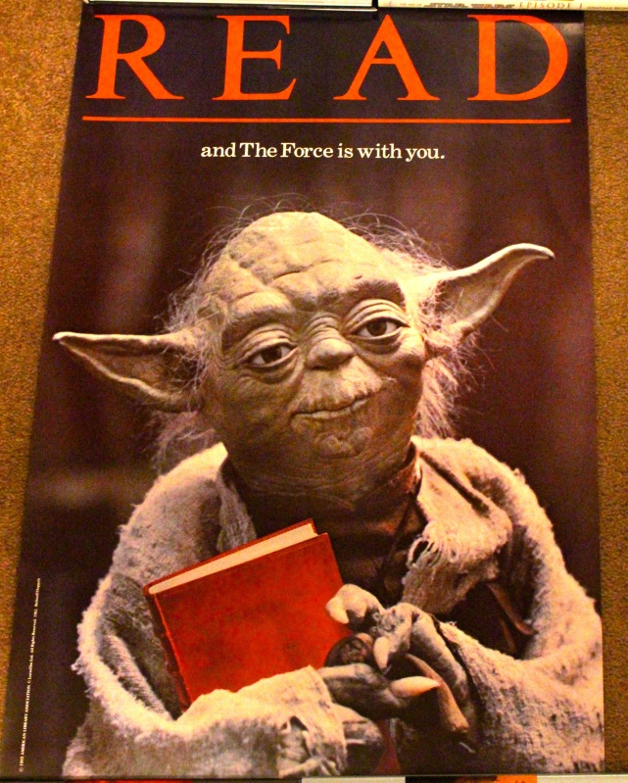
READING
CV/ PERSONAL STATEMENT
JOB INTERVIEW
RELAXATION
VOCAB
READING SPEED
FOCUS/ CONCENTRATION

