Slide 1
Notes:
Definition: Ability to find information and make a judgement about it’s quality.
Digital Literacy? Add the word ‘online’ to the definition above
Library connection?
Finding your way to the physical books and accessing/ searching catalogue to find more materials (incl. digital) in the 1000s of items available.
Most independent study/ research is done in the library= poor quality searching resulting in too much info to sift through or poor quality results.

Slide 2
How information is organised
Books vs Web
Finding & using information
Plagiarism

Slide 3
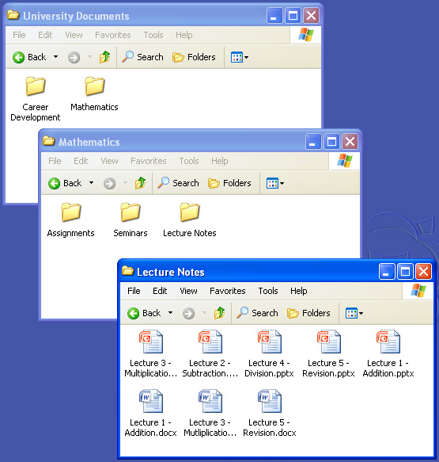
Organising information: what’s the point?
To find things easily- make it accessible
Makes sense= logical
Placed in context- Understanding the wider picture.
Notes:
Organising information- what’s the point?
To find things easily- make it accessible
Makes sense= logical
Understanding of the piece of information in the wider picture.

Slide 4
Notes:
Non-Fiction or Factual books, organised by subject in Libraries
Dewey/ Subject headings
Contents (listing of contents by chapter and section with page numbers)
Index (alphabetical listings of each name and item with page numbers at the back of the book)

Slide 5
Rugby 796.333
Ball Games 796.3
Tennis 796.342
Football 796.334
Sport 796
SUBJECT ARRANGEMENT
General to specific

Slide 7
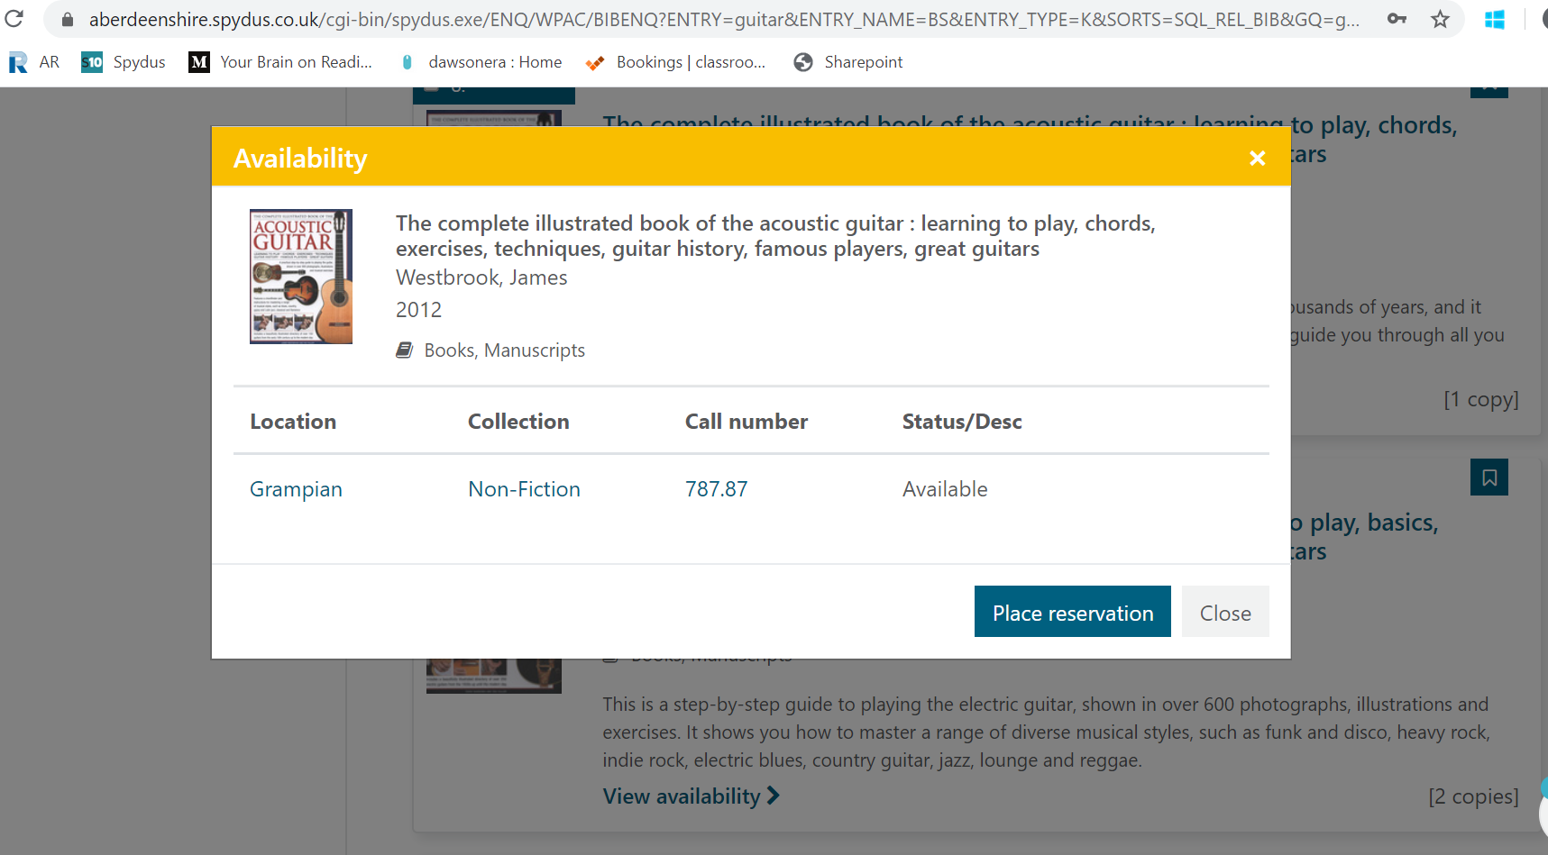

Slide 8
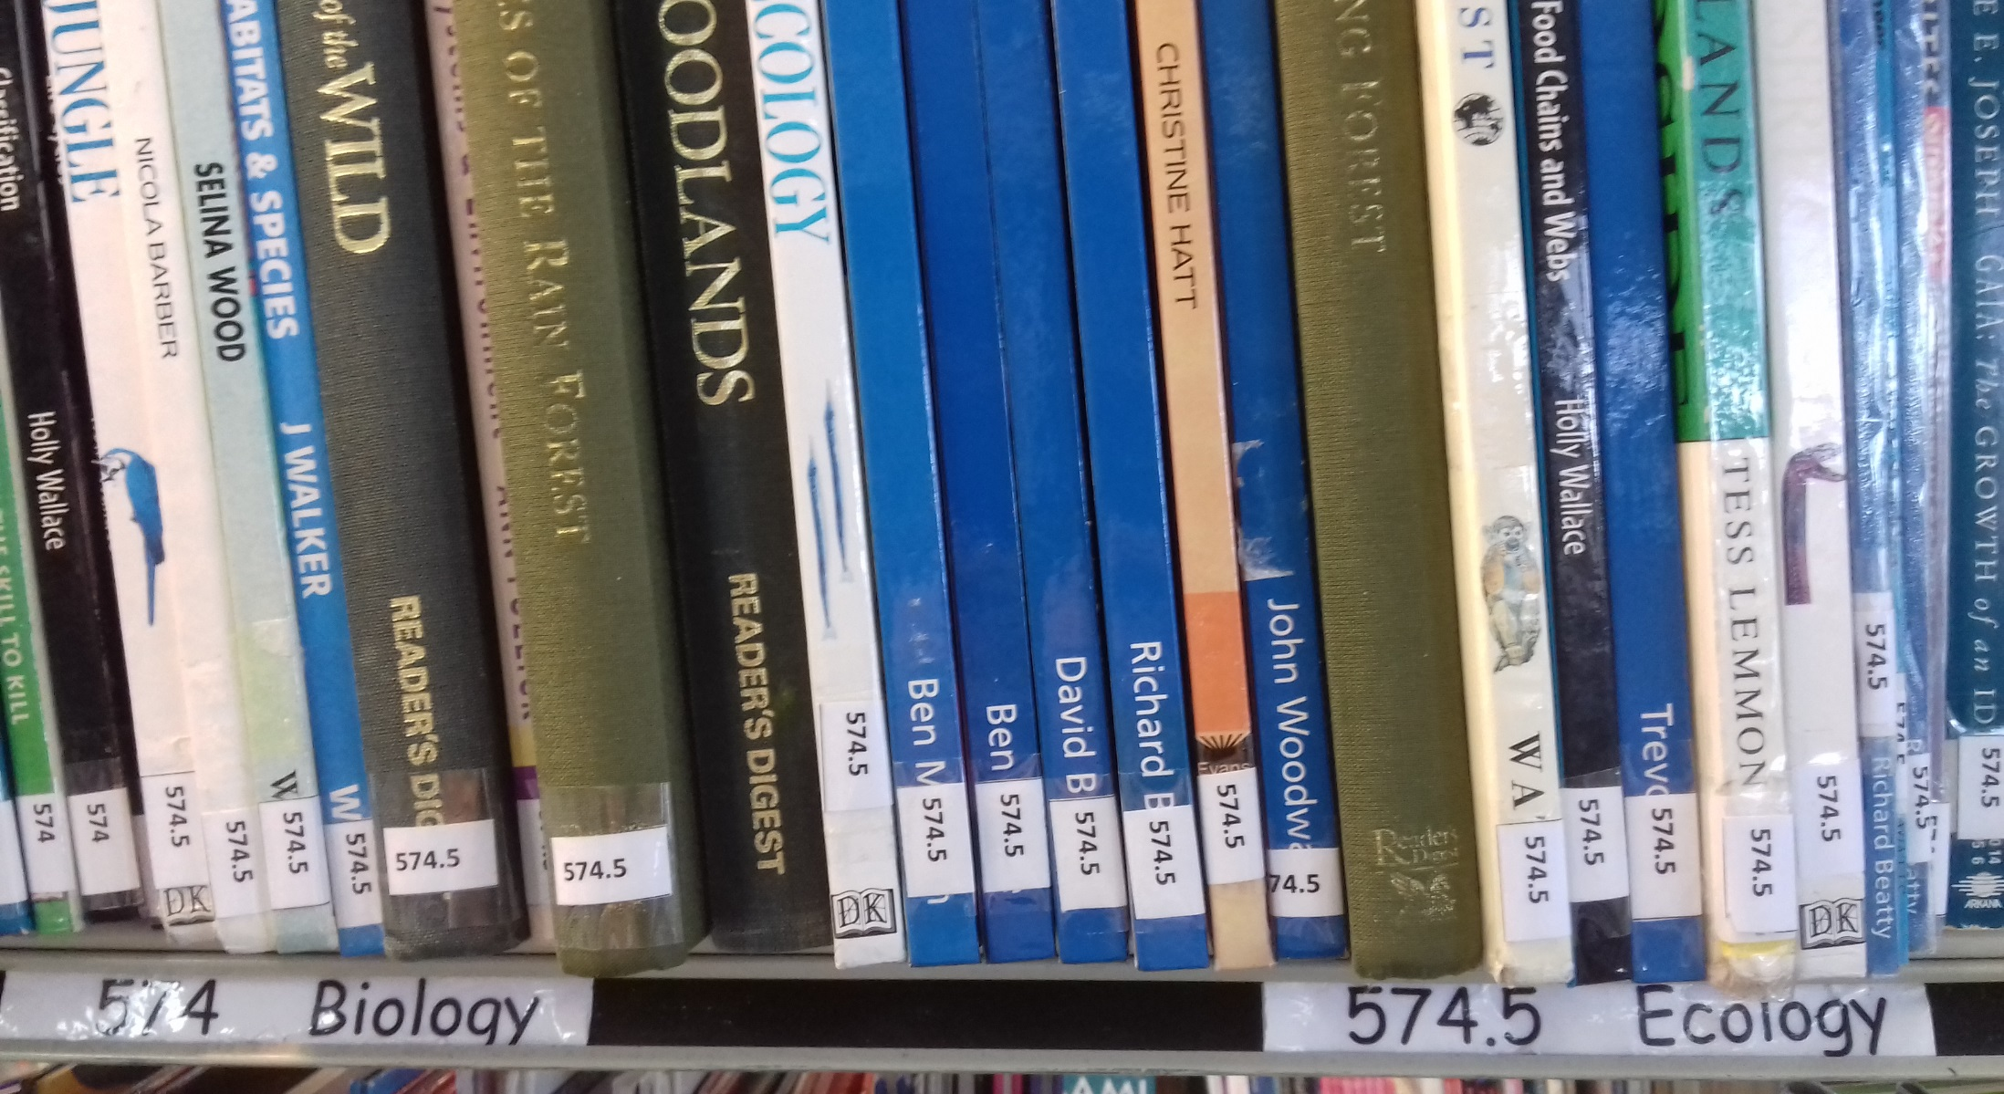

Slide 9
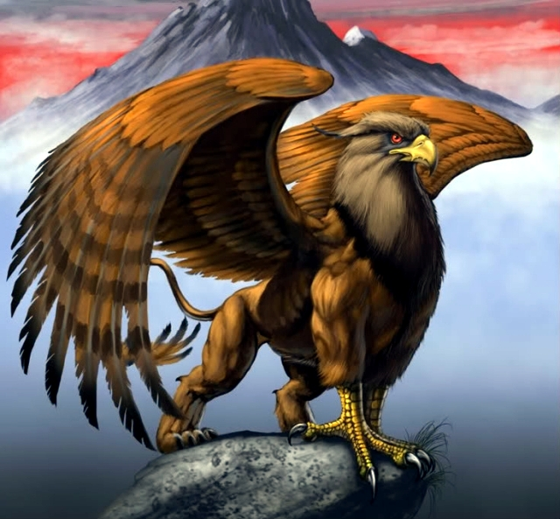
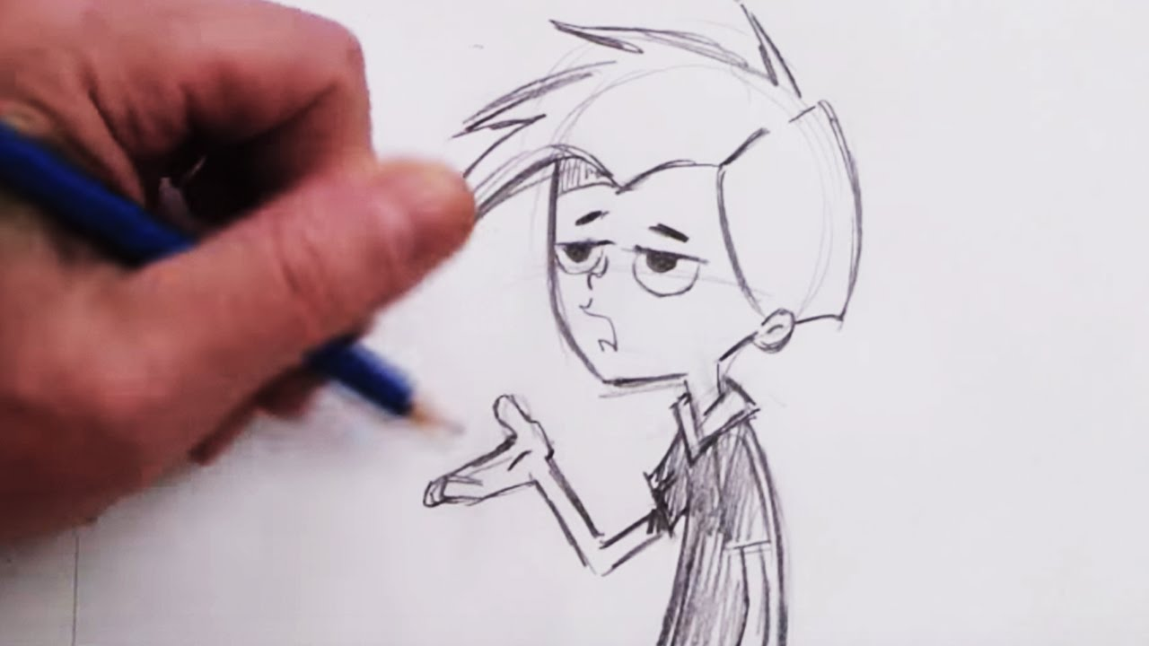
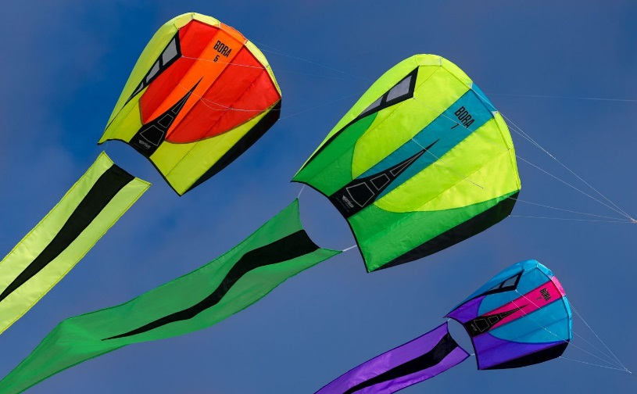
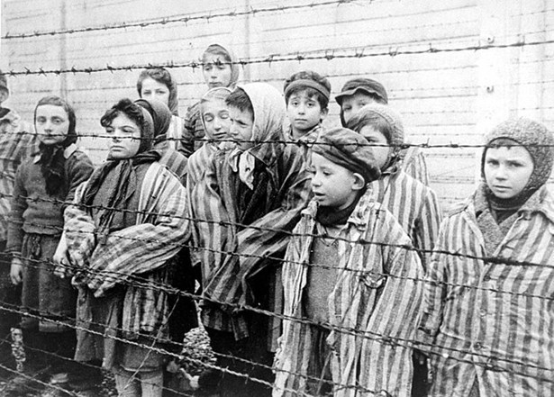
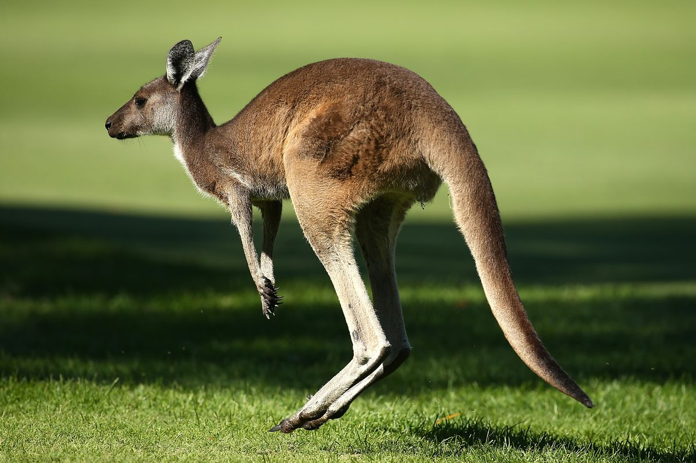
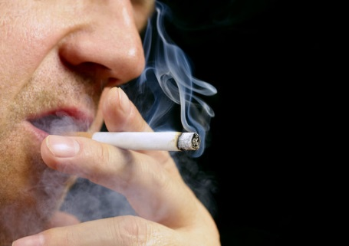
Cartoon drawing
741.5
Camping
796.54
Legends
398.2
Rivers
551.48
Kites
796.1
Holocaust
940.53
Smoking
362.29
Kangaroos
599

Slide 10
A (Specific) B (General)
Saturn Pets
Rain Farming
Acorns Cooking
Hitler Astronomy
Whales Weather
Sheep Second World War
Soup Trees
Ferrets Mammals

Slide 11
A | B | Dewey No.
Ben Nevis | GEOGRAPHY- Scotland LEISURE- Mountaineering | 914.1 796.5
Adders Berlin Buses | REPTILES- Snakes HISTORY- Germany- Air drop HISTORY- Germany- The Wall TRAVEL- Berlin TRANSPORT- Buses ENGINEERING- land vehicles- Tests | 597.96 943.087 943.155 914.3155 388.32 629.283

Slide 12
Using a book
Contents page Does it cover your topic?
Chapters Which ones will you read?
Index Keywords, bold type, page numbering
Glossary A brief dictionary of the key terms
Publication page Publisher? Date of publication?
About the author Qualifications?
Reading level Difficulty of the text?
Notes:
EXERCISE- POST-IT NOTES ON BOOKS

Slide 13
WORDS
Notes:
Words that best describe your subject/ unique words to the subject.
Extract them from your mindmap. Type them into a Google search or look them up in chapter headings/ Index of a book.
Antonyms are two words that have opposite meanings (Freeze – Boil, Full – Empty).
Synonyms are words that have the same/nearly the same meaning (young people= teenagers, youths, juniors or Destitute, poor, bankrupt, impoverished).
Homonyms are words that are pronounced the same (Aisle - I’ll – Isle or Chilly - Chili – Chile) and are sometimes spelled the same, but have different meanings (live, arm).
Acronyms are abbreviations of terms/ organisations based on first letter of each word (BBC, NATO, ASAP, YOLO).
No luck with your chosen words? Try a different set of keywords or different combinations, remember: there is no correct set of words to unlock all the information.
1-KEYWORDS EXERCISE (Research & Keywords doc)

Slide 14
‘Discuss fully the relevance of access to public libraries for young people in the digital age.’
‘Give a comprehensive and clear overview of literacy and the Irish traveller community in the 21st century.’
‘Does social media impact on political engagement of the population of developing countries?’
‘Is research involving the use of embryos ethically acceptable?’
‘Give an overview of the effects of the War on Terror on race relations in West Yorkshire.’
Notes:
Discuss alternative keywords (synonyms),
importance of ‘full phrases’,
eliminating common words,
widening the search or narrowing the search

Slide 15
‘How do changes in a mother’s diet during pregnancy affect the health and on-going development of the infant?’
‘Can changes in nutrition improve memory formation in children?’
‘Should advertising be banned on children’s television?’
‘How will austerity measures in the Eurozone affect small enterprises in Great Britain?’
‘Discuss the potential and actual impacts of alcohol on student well-being.’

Slide 16
‘Give an overview of the impacts of climate change on the Gulf of Mexico region water cycle.’
‘What represents value for money for university students in the UK?’
‘Discuss the side effects of consuming food and drinks containing caffeine on expectant mothers.’
‘Discuss fully the key benefits of the use of a mobile computing device in an educational setting.’
‘How can the teaching environment be changed to improve learning outcomes for dyslexic students?’

Slide 17
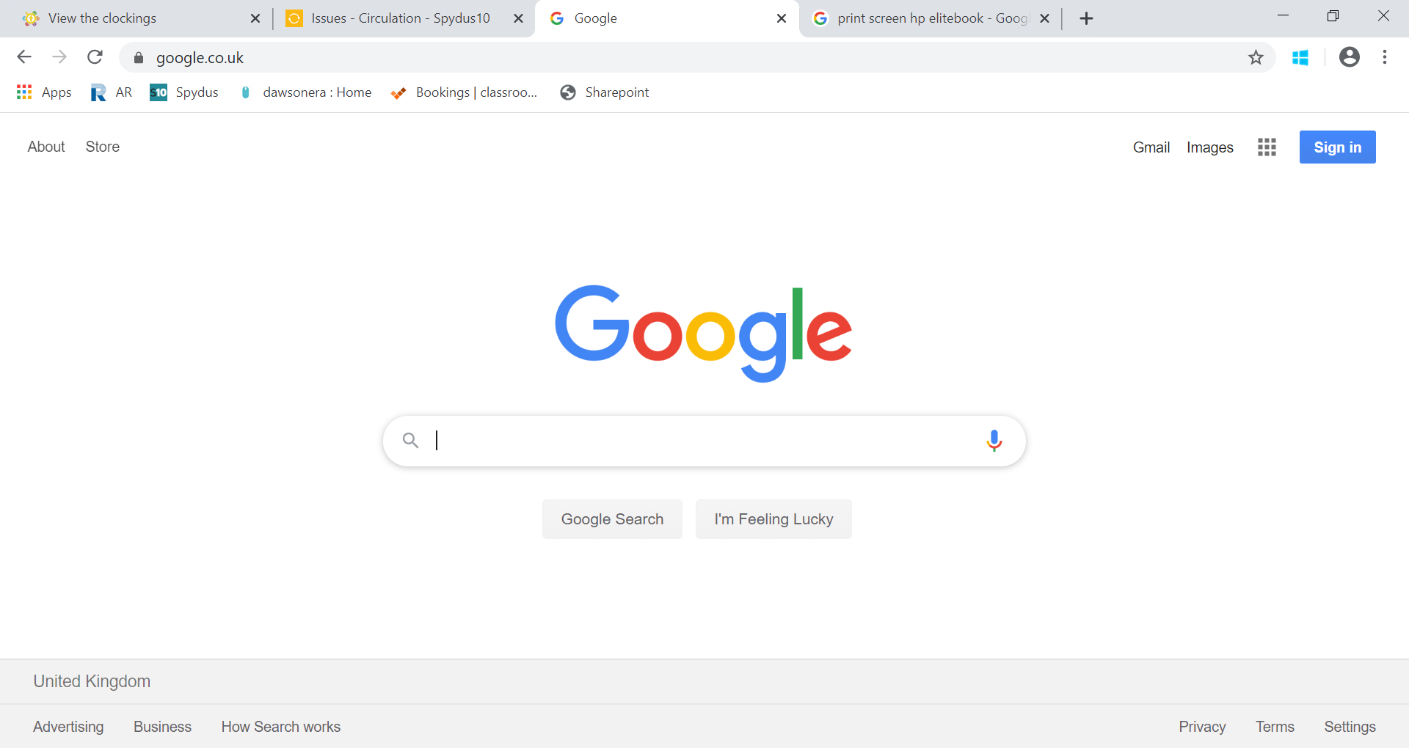

Slide 18
Proof-checked (factually accurate)
Reputable publishers
Qualified authors
Unbiased
Information is organised clearly
Instant
Easier to jump from topic to topic
A website can be found on anything and everything
More up-to-date/ current
All information has ‘equal weighting’
VS.
No standards
Accuracy is difficult to determine
Information overload
Plagiarism more likely
Difficult to see the ‘bigger picture’
Disorganised
‘Everything’ is not on the internet
Can be out-of-date quickly
Takes time to locate books (and information within)
Accessibility/ Availability

Slide 19
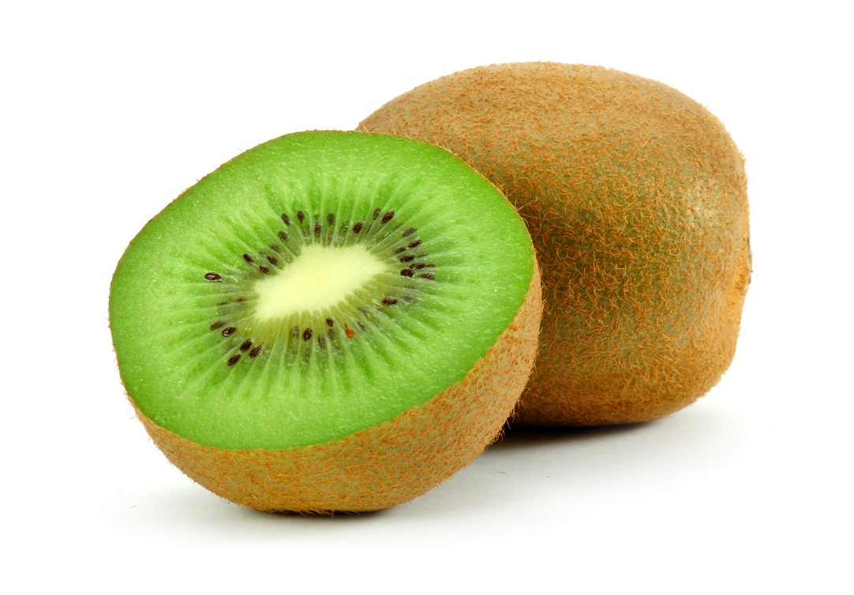
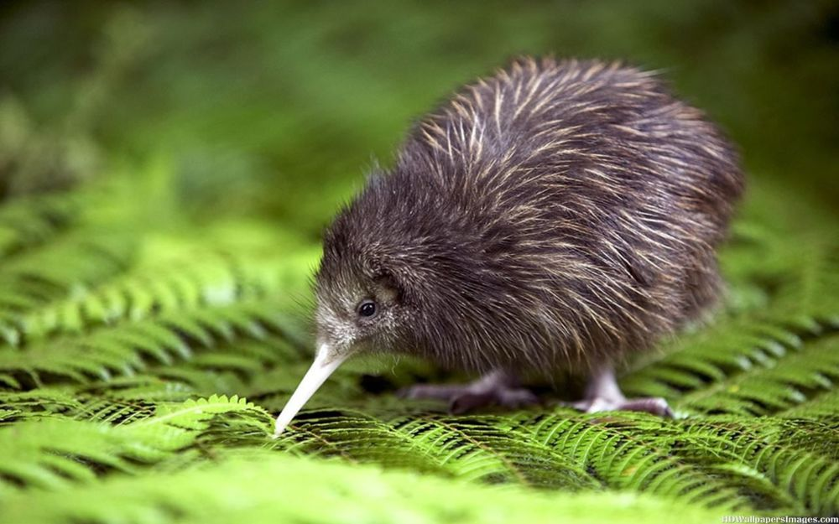
C.A.R.
Current
When was the website created/updated?
Is the information up-to-date?
Accurate
Who is the author? Credentials?
Could they be unreliable or biased?
Relevant
Does the website answer your key question?
Is it too easy/ hard/ about right?
Too much/ not enough detail?
This?
Or this?

Slide 20
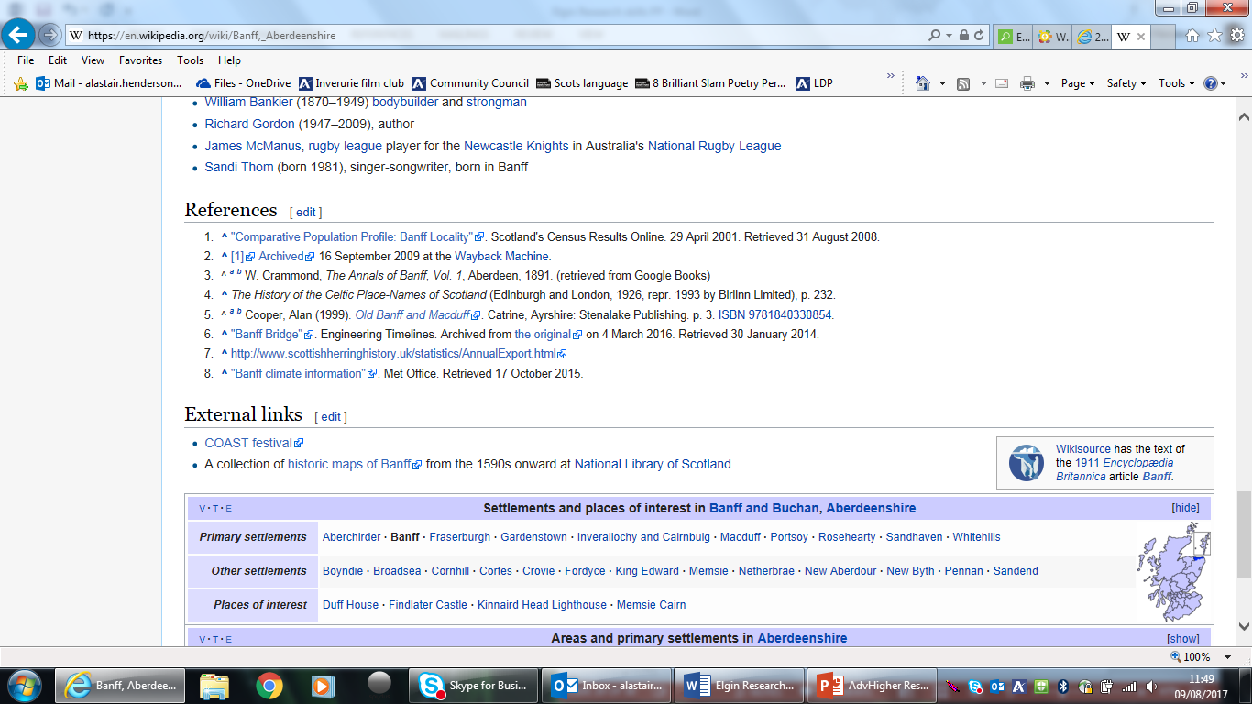
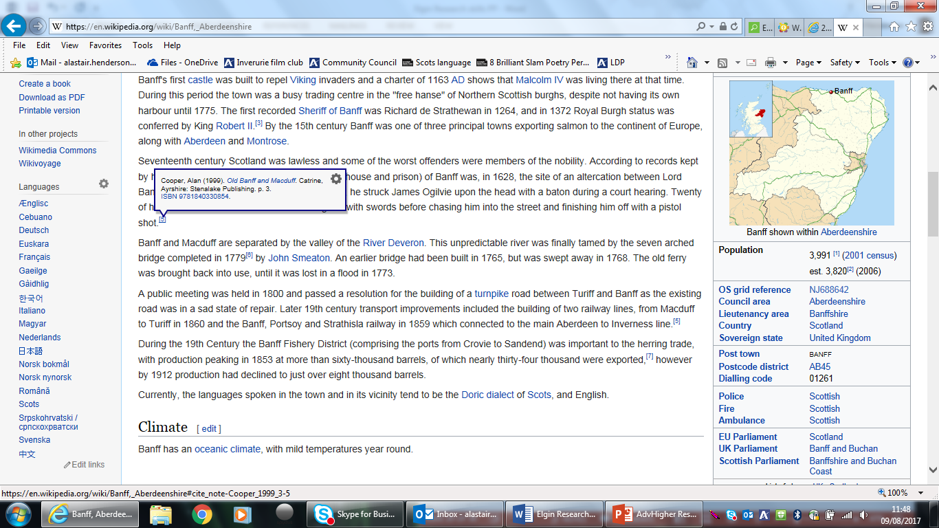
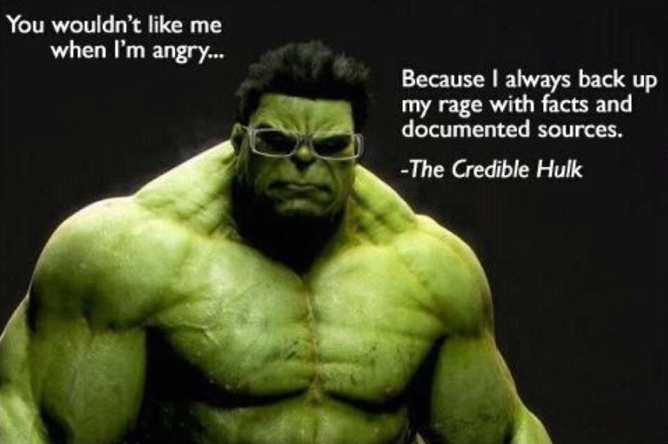

Slide 21
Why do people plagiarise?
Takes less time
Want to get a good mark
Lack of own knowledge
Lack of patience
No trust in own ability
Laziness
Ignorance about the consequences
By accident
Nkkncnvxnsmcsmdbfm
sfk
“The practice of taking someone else's work or ideas and passing them off as one's own.”
Notes:
What is it?
Plagiarism happens when one writer “steals” another writer’s ideas, words or phrases.
It’s cheating and it’s breaking the law- how would you like it if someone stole your work and passed it off as their own?
Very easy to do on the internet where it’s unclear who owns what.
How to avoid it
Avoid Copy and Paste
Put it into your own words (also ensures you understand what you are reading)
Make sure you include the source in your list of references!
If using someone else’s words: quote in full, with quotation marks.
Referencing/ Bibliography: goes at the end/ should include all the sources you have consulted.

Slide 22
Example 1:
‘I copied and pasted a paragraph from the Internet into my report without changing any words. Information on the web is free after all…’
Notes:
Answer: This is plagiarism.
Straight copying from any source - a book, a magazine or a website – without changing any words is cheating and the most commonly committed form of plagiarism.
EXERCISE 4

Slide 23
Example 2:
‘I used the ideas of an author and wrote them in my own words in my research.’
Notes:
Answer: Plagiarism.
Using the ideas of another, even when you write them in your own words and don’t say where the original idea came from, is also plagiarism

Slide 24
Example 3:
‘I submitted parts of the same essay for two different projects.’
Notes:
Answer: Plagiarism.
This is self plagiarism and is also not allowed.

Slide 25
Example 4:
‘I copied a diagram I liked from the Internet but put a note beside it to say where I’d copied it from.’
Notes:
Answer: This is correct and not plagiarism.
This is referencing a source correctly. You didn’t create the diagram but you’ve stated where you got it from.

Slide 26
Example 5:
‘I copied a few lines of a paragraph from a newspaper article. I enclosed them in quotation marks and presented the information as a quote from a newspaper.’
Notes:
Answer: This is correct and not plagiarism.
Another example of referencing a source of information correctly.

Slide 27
Name two broader terms for television.
Examples: media, broadcasting, telecommunication, TV
Your research question contains the words ‘Young People’. How many synonyms can you think of?
Examples: Teenagers, juveniles, kids, pupil, junior
Notes:
Whether ‘Google searching’ or using the index of a book:
Important to broaden your search with different (or more general terms) if search results are unsatisfying
If search terms are too specific you may miss something/ Something useful ay have been ruled out
Conversely, if results are too general, you’ll get lots of irrelevant/ general results.

Slide 28
Different types of information are published at different speeds. Put these in order (fastest first).
Encyclopaedia
Website
Journal article
Newspaper article
b, d, c, a
How long does it typically take to publish an academic book?
1-2 weeks
1-2 months
1-2 years
c. 1-2 years
Notes:
Big advantage of the internet over books: currency/ speed
Big advantage of books over internet: authority (written by experts/ checked by experts)

Slide 29
You’re starting a completely new subject area and are a little lost. What would be the best place to look for a short overview on a new topic?
An encyclopaedia
True or false: You can find all the information you need on the internet if you know how to look for it.
False: Not all information is published on the internet

Slide 30
Name some risks when quoting information from unchecked websites
Examples: bias, spoof or intentionally misleading, out-of-date, too little detail, unverified facts or data
Your teacher recommends a book but doesn’t tell you which page(s) to read. What’s the best course of action?
Read a review of the book
Read the introduction
Look at the contents page and the index for relevant topics
Read the whole book
Look at the contents page and the index for relevant topics

