Slide 1
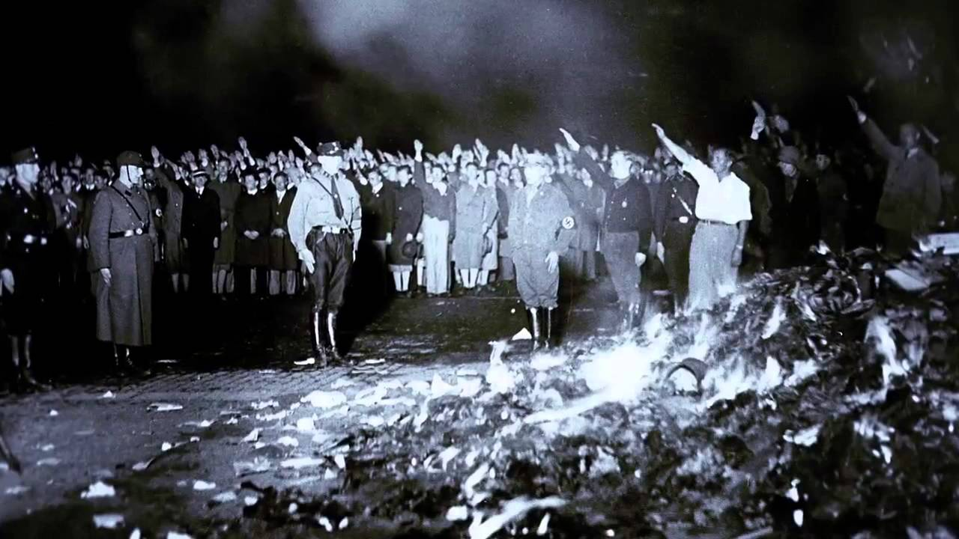
Usually for racial or religious reasons (veiled as something else)
Not uncommon even in ‘modern’ societies (despite laws and individual freedoms)
Rarely without opposition- usually from teachers, librarians and people who oppose intellectual suppression
Banning Books
Notes:
Book banning is not an uncommon concept even in modern society despite laws and individual freedoms that are supposed to prevent it. Book banning is rarely without opposition from educators and people who oppose intellectual suppression.
Typically, when books are banned, the underlying reason is racial or religious, but often veiled as something else.

Slide 2
Available from the Digital Library as an eBook
Available from the Digital Library as an eAudiobook
Not currently available from the Digital Library

Slide 3
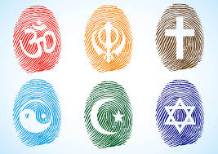
RELIGION

Slide 4
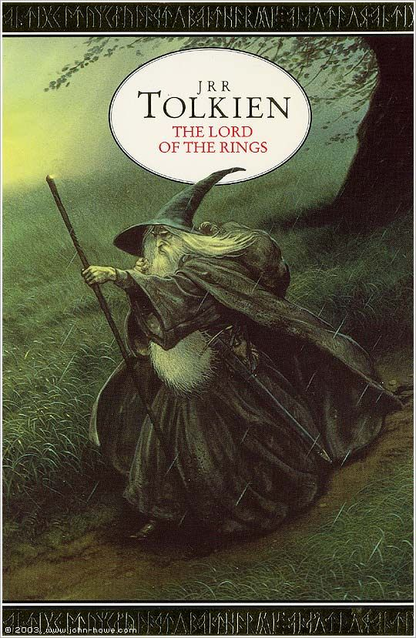
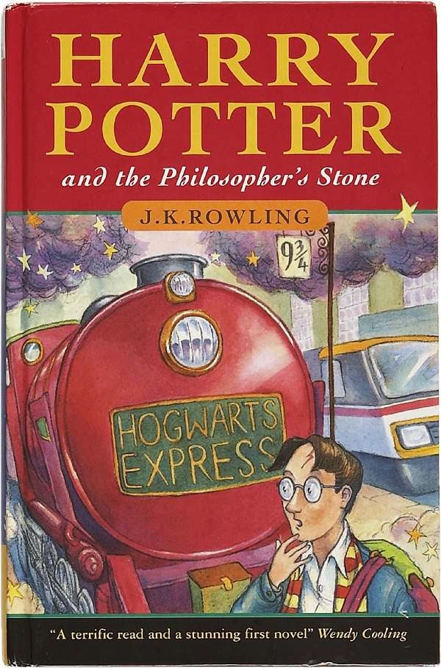
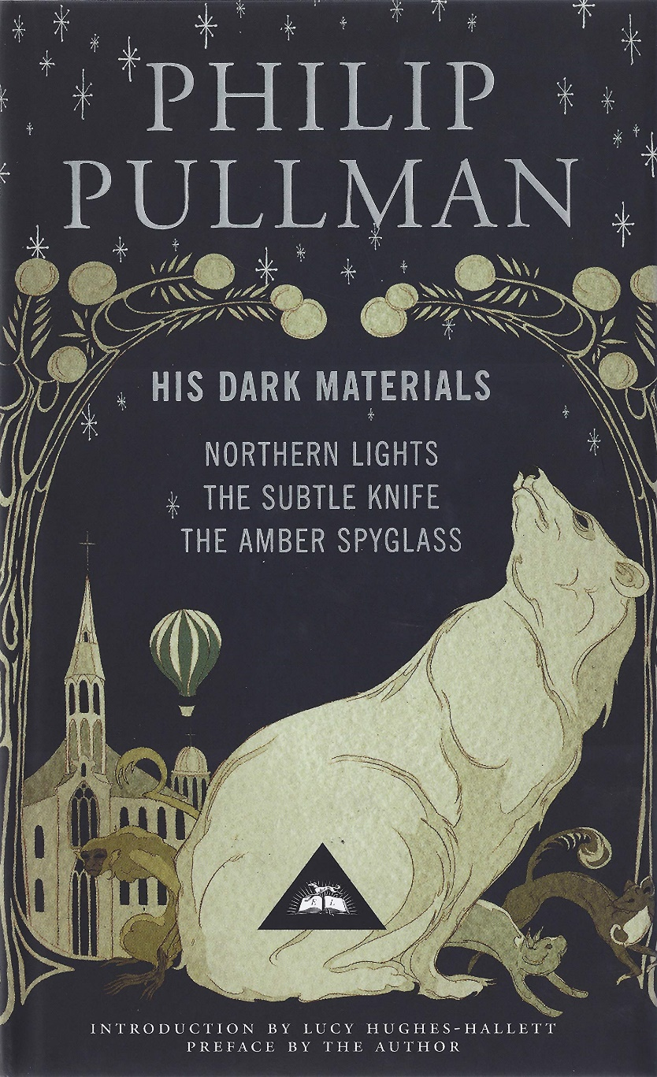
Notes:
The Lord of the Rings - JRR Tolkien
Tolkien's epic fantasy trilogy follows good and evil forces in pursuit of a magical ring. The book has been banned as 'satanic' in some areas and was even burned by members of a church in New Mexico in 2001. The controversy is ironic, though, as Tolkien was a devout Christian and many scholars note Christian themes in his work.
What’s it about?
The first of the hugely successful Harry Potter series, in which Harry discovers he's a wizard, and enrols in Hogwarts School of Withcraft and Wizardry.
Why banned?
Banned and burned in many US states for promoting witchcraft, and also banned in some Christian schools in the UK. Maybe they didn't realise it is just a story.
His Dark Materials - Philip Pullman
This much lauded trilogy, full of references to and inspired by a range of literary classics, has been criticised mostly in the USA for its apparent attack on the church and religion in general, and Pullman does admit the books are about “the killing of God”. To add to the books’ controversial nature, passages alluding to the sexual awakening of its main female character, Lyra, have been removed in some editions.

Slide 5
MATURE
CONTENT

Slide 6
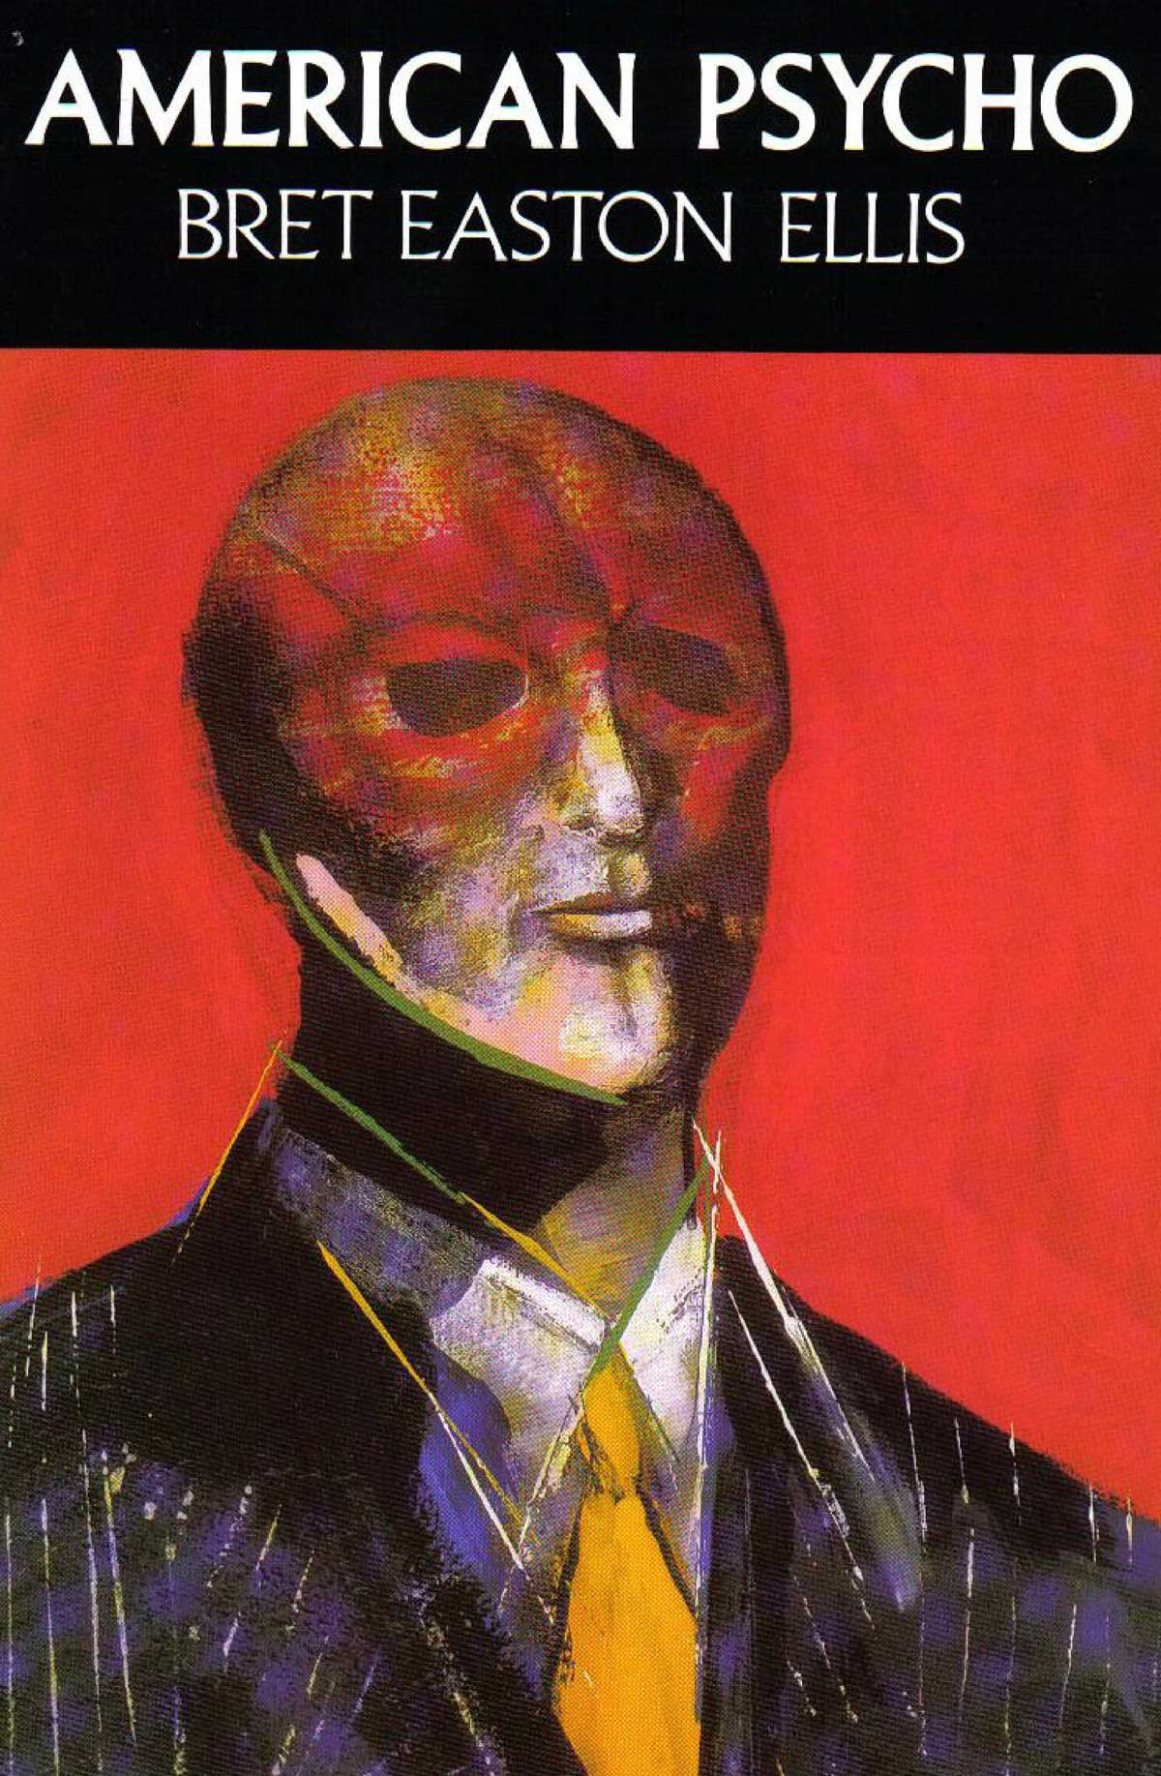
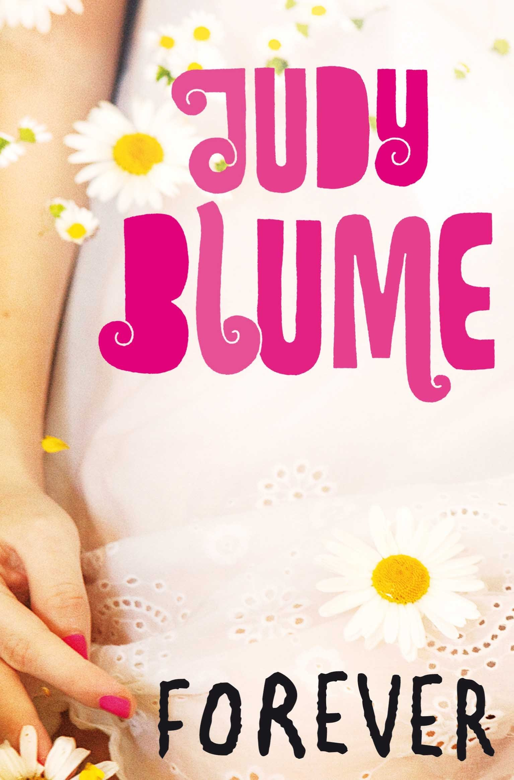
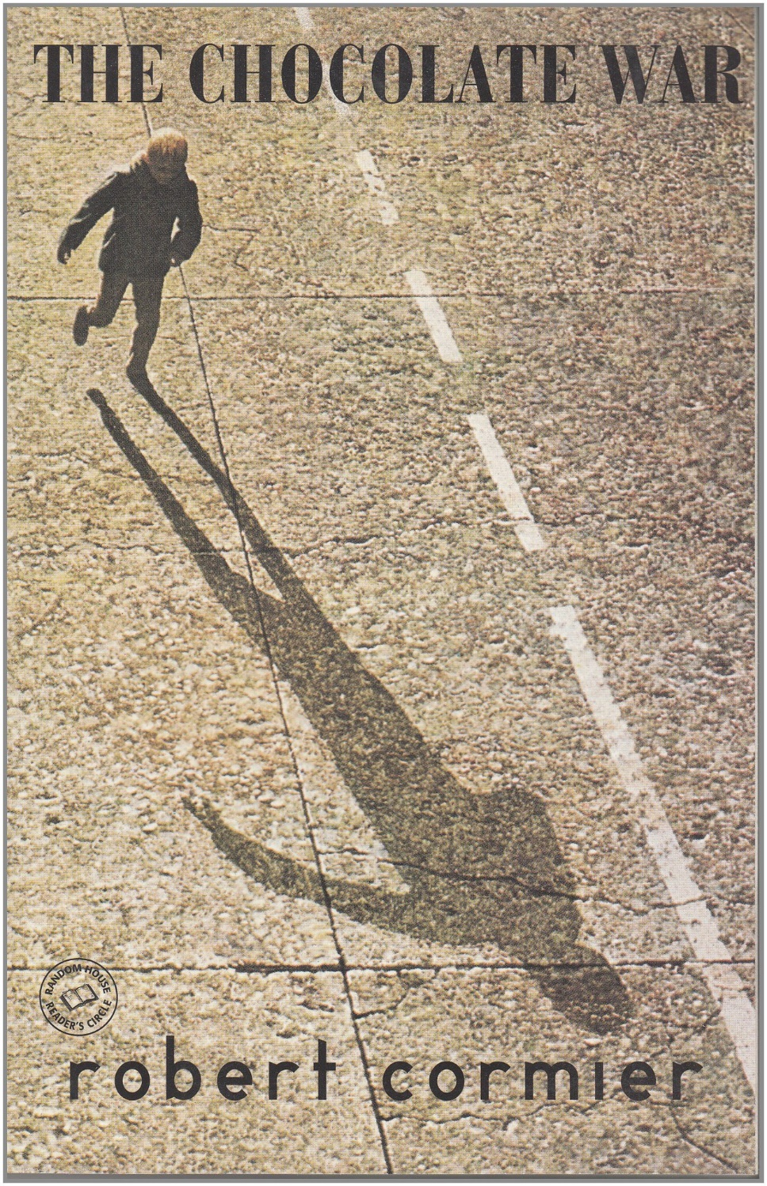
Notes:
American Psycho
A satire of 80s Wall Street Yuppie culture. The original publishers of this book dropped it and when it was published in 1991 the New York Times urged people not to buy it because of its extreme violence. In Germany, Australia and New Zealand it was shrink wrapped and sold to over 18s only.
Forever
Blume's 1975 novel tackles themes of teenage sexuality head on. One of the most frequently challenged books in the US because of the use of suggestive language, the detailed depiction of sex, and because her teenage character, Katherine, goes on the pill.
The Chocolate War - Robert Cormier
Considered to be one of the best ever young adult novels, it comes fourth in America’s list of banned books 1990-2000. Dealing with high school gang culture, the main challenges were on the grounds of sexual content, violence and bad language.

Slide 7
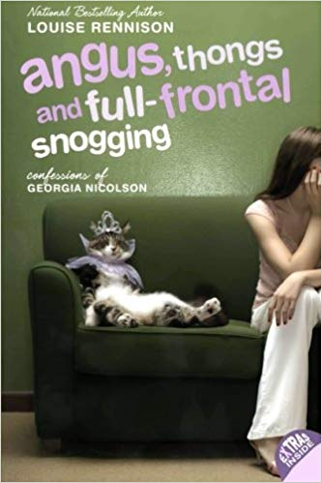
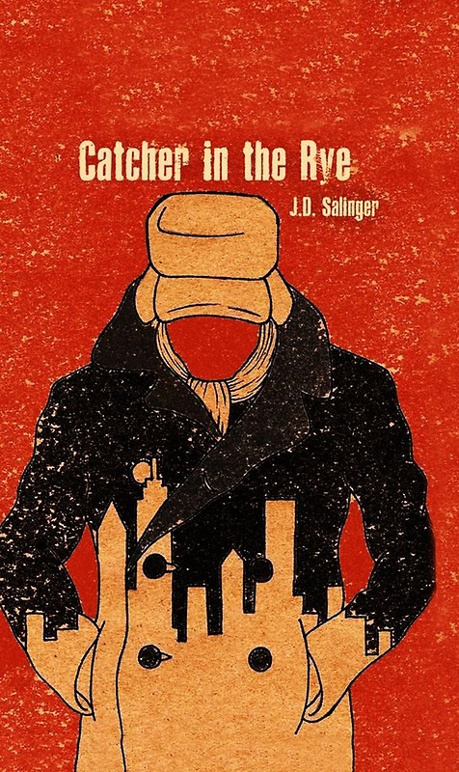
Notes:
Angus, thongs and full frontal snogging - Louise Rennison
The first in the hugely popular Confessions of Georgia Nicolson series, its frank discussion of boys, and references to lesbianism and pornography have made Angus... a target for censorship in US schools.
The Catcher in the Rye - JD Salinger
The story of the frustrated and confused Holden Caulfield has been banned by many schools and libraries since its publication in 1951. The censorship primarily stems from the book's profanity and sexual references. It's also commonly under fire for its perceived immorality.

Slide 8
RACE

Slide 9
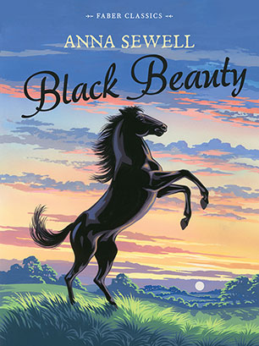
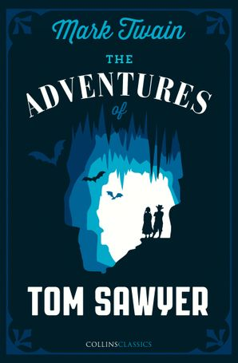
Notes:
Black beauty
With more than fifty million copies sold worldwide, Black Beauty is one of the best-selling books of all time. It extols the virtues of kindness and respect. It was banned by the South African government during the Apartheid era (a system of institutionalised racial segregation that existed in South Africa and South West Africa from 1948 until the early 1990s.) because of the word 'Black' in the title!
The Adventures of Tom Sawyer - Mark Twain
Alongside Huckleberry Finn, this book has attracted controversy for its use of racially charged language. In fact, this novel of a young boy growing up along the Mississippi River not only raised important questions of racial inequality that are still with us today, but revolutionised modern American story telling into the bargain.

Slide 10
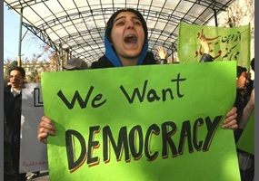
POLITICS

Slide 11
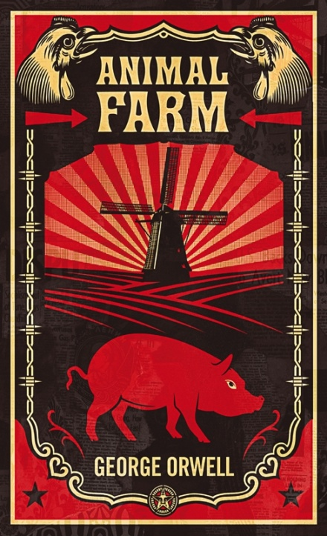
Notes:
Animal Farm
This book restages the Russian Revolution on an English farm.
It powerfully demonstrates the importance of democracy and freedom of speech.
It is still relevant today with its tale of corruption and misinformation in a worker's revolution that goes wrong.
Why banned?
In the 1940s, Allied forces found the book critical of the USSR, and therefore considered too controversial to print during wartime.
A play of Animal Farm was banned in Kenya in 1991, because of its criticism of corrupt leaders.
In 2002 it was banned in schools in the United Arab Emirates.
One day in the life of Denisovich
The story is set in a Soviet labour camp in the 1950s, and describes a single day of an ordinary prisoner, Ivan Denisovich Shukhov. Banned in the USSR for political reasons. The author was sent into exile.

Slide 12
ALL OF THE ABOVE

Slide 13
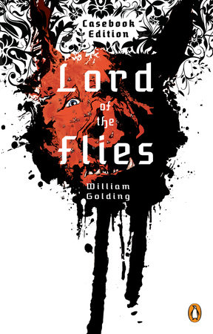
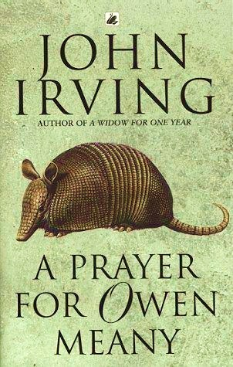
Notes:
Lord of the Flies - William Golding
Despite widespread acclaim and popularity, Lord of the Flies has been banned for a plethora of reasons. Many critics complain about violence, language, sexuality and racism. Others accuse the novel of attacks on religion, the disabled and women.
A Prayer for Owen Meany - John Irving
Banned in some US states for its views on religion and criticism of the US government for the Vietnam War and Iran-Contra. This book tells the story of John Wheelwright and his friend Owen Meany growing up together in a small town in New England, in the 1950s and 60s. Its a mystical book - Meany believes he is an instrument of God, to be redeemed by martyrdom - but full of comedy. Essential banned reading!

Slide 14
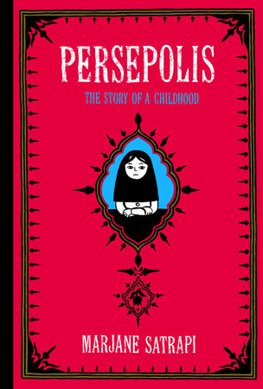
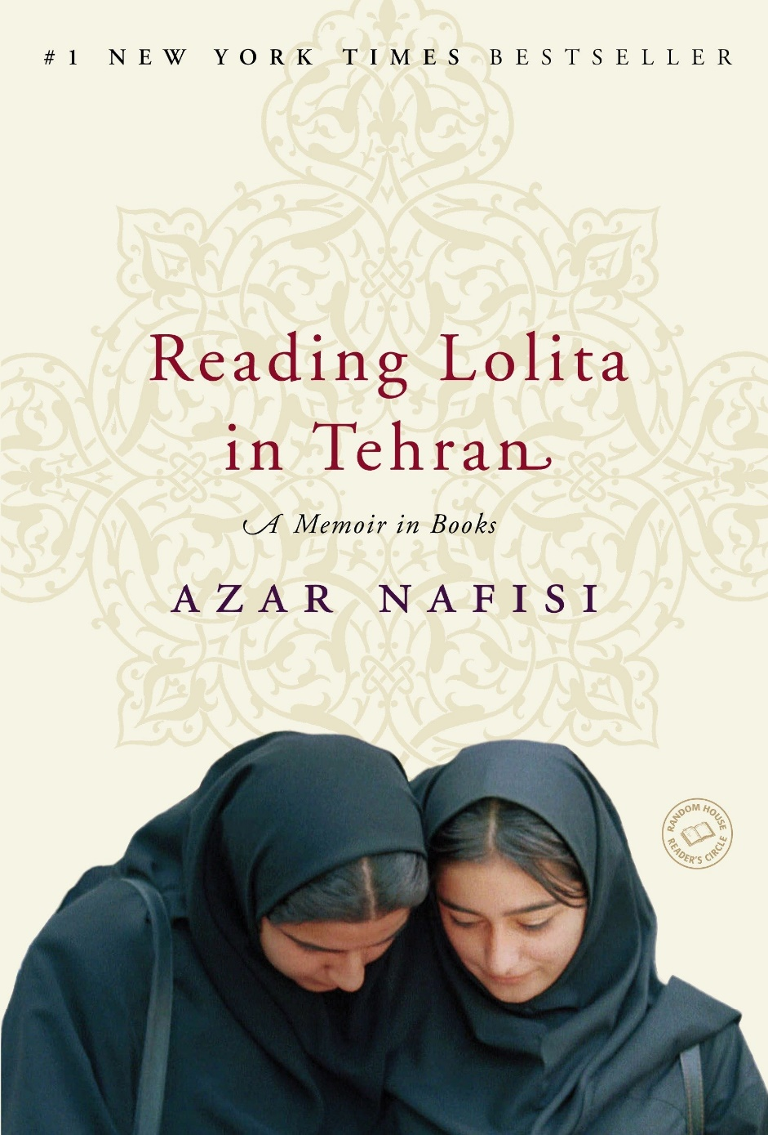
Notes:
The graphic novel Persepolis (2000) has become a hit everywhere in the world except Iran where it is banned. The novel details the life of Marjane Satrapi who spent her childhood in Tehran during the Iran and Iraq war, which is known as the Islamic, Shah or Iranian revolution. Satrapi is 10-years-old when the novel begins and describes her experiences of religious and gender oppression. Surprisingly it was also banned in Chicago public schools for a while over Islamaphobia concerns and mature content.
It joins Azar Nafisi's 'Reading Lolita in Tehran’ (2003) which is banned in Iran too. The author refused to submit to the rule to wear the veil and this led to her expulsion from her University job.

