Slide 1
Research Skills
Planning
Locating
Using

Slide 2
Get Organised!
A jumble of disorganised information can lead to:
Errors (inadequate fact-checking)
Plagiarism (accidental, no referencing)
Duplication (unwittingly revisiting sites or journal articles)
Wasted time (correcting mistakes, rewriting, restructuring, see ‘duplication’)

Slide 3
The Big Picture
When asking questions, you must first have a workable topic.
Some subjects, like THE GALAXY, are too big to handle in one question.
Likewise- don’t go too small (answerable in a paragraph or sentence)

Slide 4
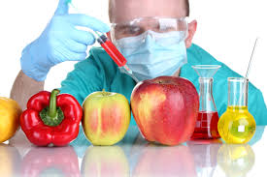
Unpacking the Question
A simple question: Should GM food be allowed?
Leads to more questions:
Should genetic modification of food be allowed?
What are the issues surrounding the question?
Which countries have bans on genetically modified foods, or the growing of genetically modified crops?
Are there economic effects as a result of the growing of GM foods?
Should biotechnical companies be able to patent the GM crops they produce?
Why would it be a good idea to allow the growing of GM crops that can withstand heat, cold or drought?
Can GM food crops have an effect on Biodiversity?

Slide 5
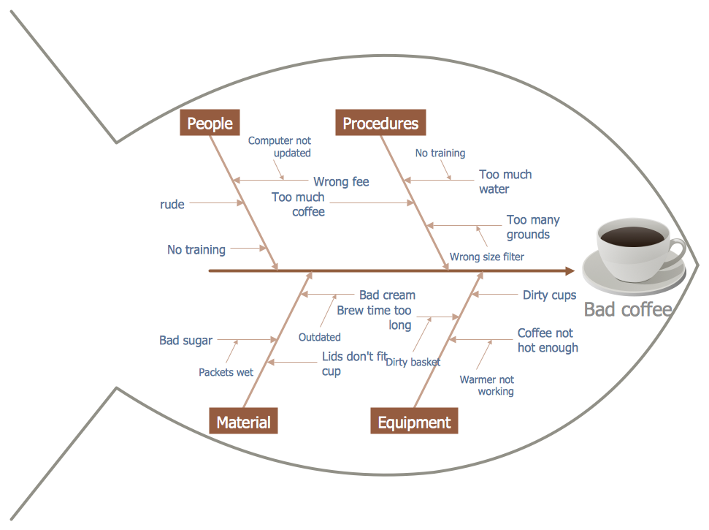
1-Fishbone maps
Many elements to your topic?
Main idea in the middle.
Each ‘bone’ contains a major point (or ‘facet’) of the main idea.
Fill in the smaller sections with facts about those points.

Slide 6
2- Concept web
Ecology
Tropics
Deforestation
Evolution
The centre circle (green)= research question.
Each branch (orange)= your main ideas.
These subheading bubbles have supporting facts or details (blue).
Rain Forests
Climate changes
Biological Diversity
Forest conservation
Extinction
Endangered species
Species Diversity
Rare Birds
Rare Plants

Slide 7
3-Problem-Solving Model
How can Global Warming on earth be reduced?
In the ‘problem’ box, you state the problem.
The ‘possible solution’ boxes are filled in based on the facts you found in your research.
The ‘possible result’ boxes are then filled in across from each possible solution with a possible result.
The conclusion box will be filled in by you drawing a conclusion from each of the possible solutions and their consequences.
Possible solutions Possible results
Possible solution 1 Possible result 1
Possible solution 2 Possible result 2
Possible solution 3 Possible result 3
Conclusion

Slide 8
A combination of Roman numerals and letters to represent each topic, subtopic and supporting details.
Graphic Outlines use complete sentences to arrange the topics, subtopics and supporting details for the research questions.
4-Graphic Outlines
Cxxvbcbvbbbbbbbbbbbbbbbbbbbbbbbbbbbbbbbbbbbbbbbbbbbbbbbbbb
Ccbbbbbbbbbbbbbbbbbbbbbbbbbbbbbbbbbbbbbbbbbbbbbbbb
bbbbbbb

Slide 9
“Trust but Verify” –Ronald Reagan (Russian Proverb)
Use a variety of sources to get information.
This helps verify the information
Using more than one source may also provide different points of view on a topic.
It’s also important to have a good balance of physical and electronic sources.

Slide 10
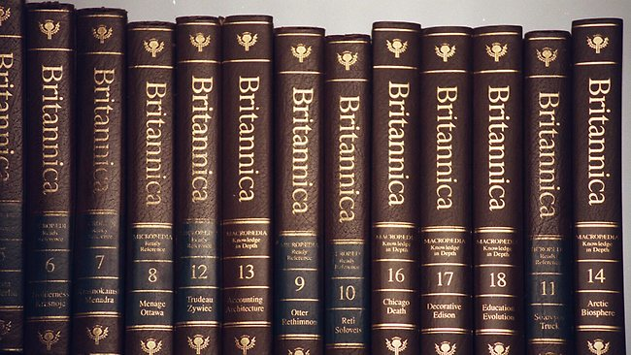
Physical Sources
Reference Books
Dictionaries
Atlases and Almanacs
Periodicals
Primary Sources
Television
DVDs

Slide 11
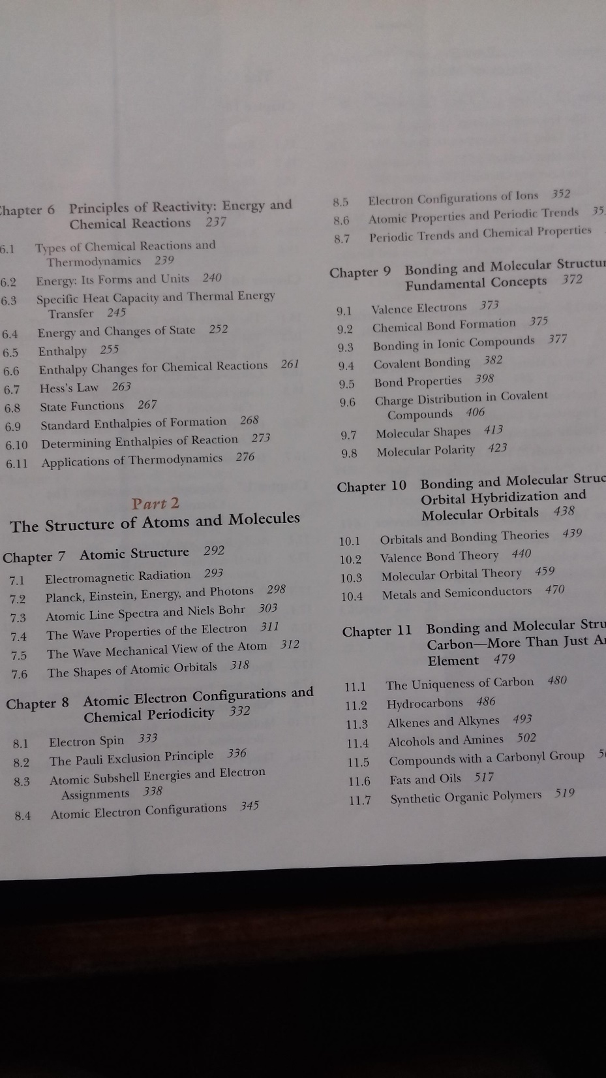
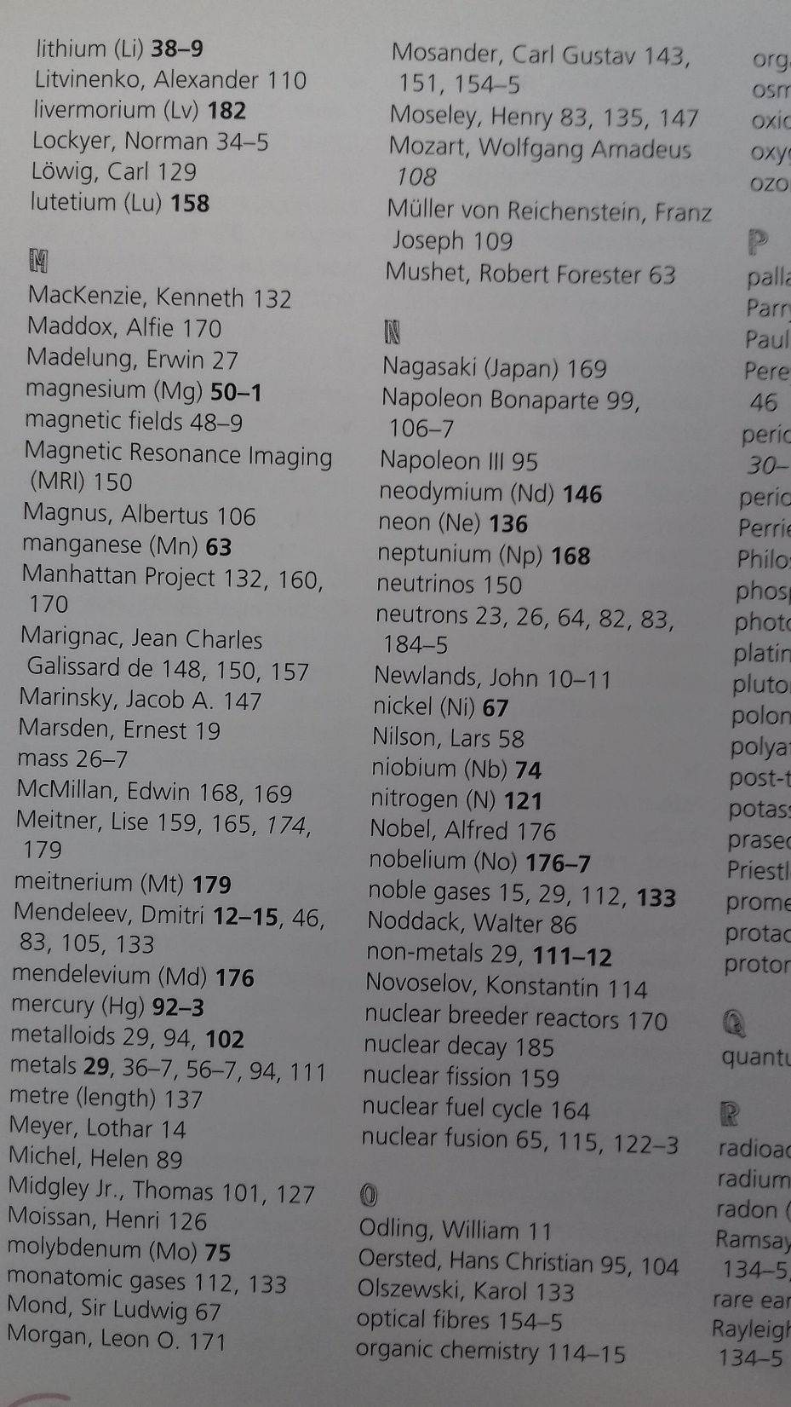
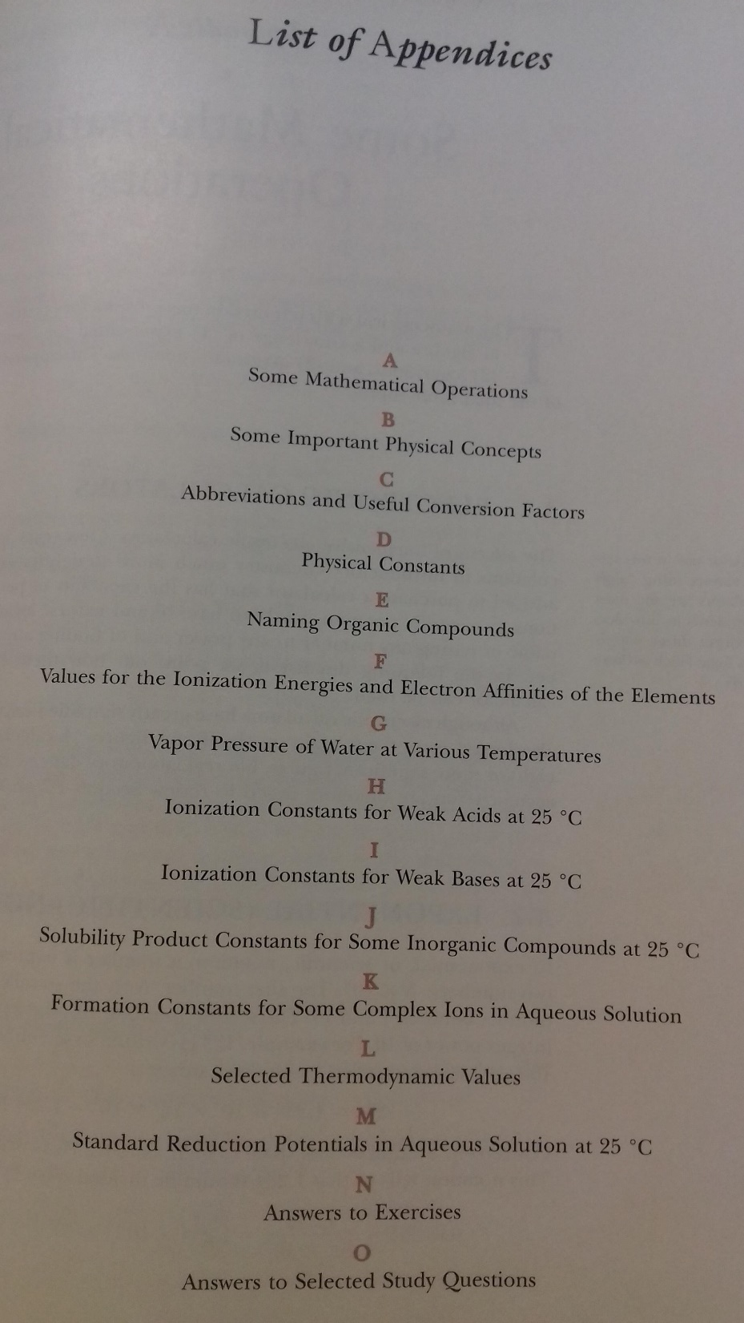
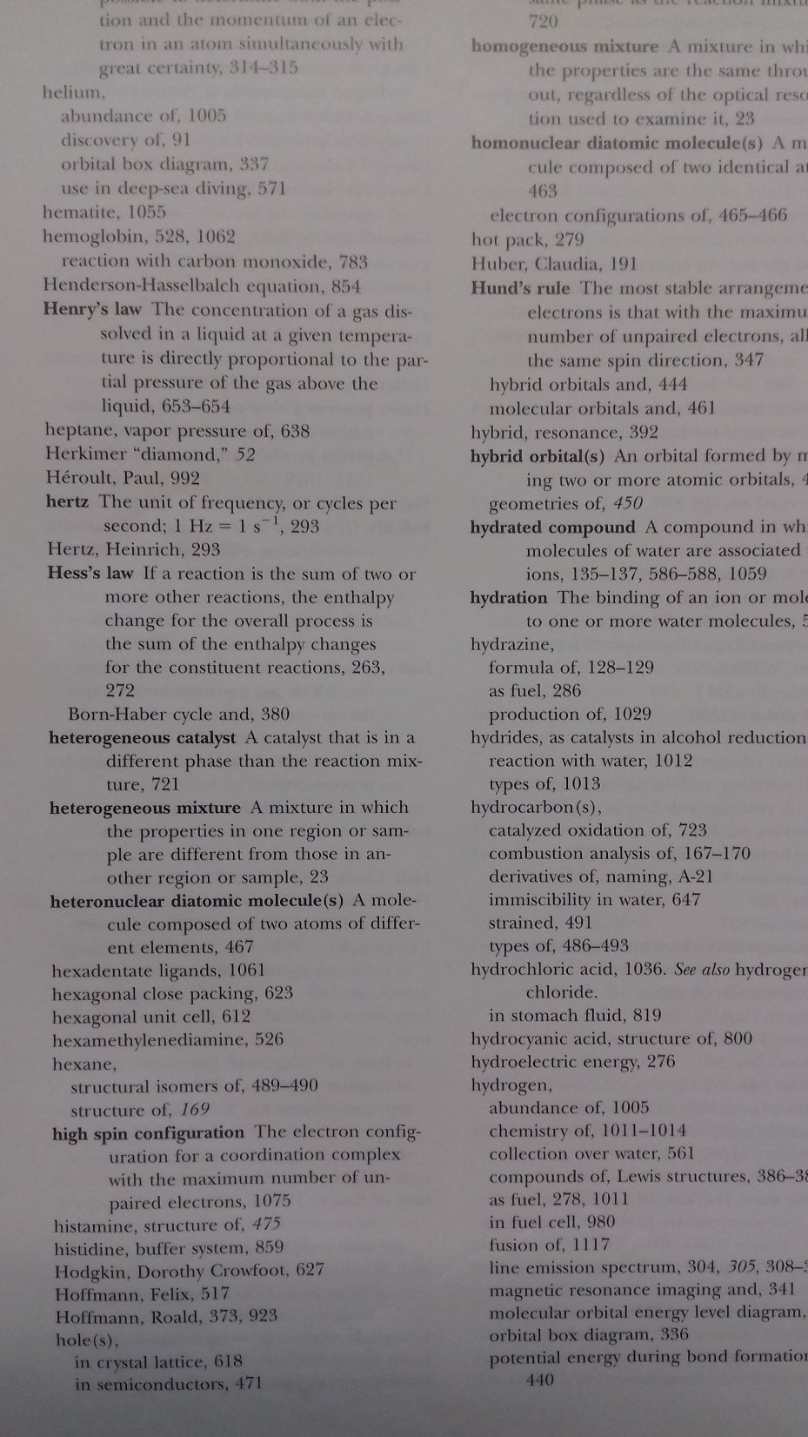
Contents page
Appendices page
Index page

Slide 12
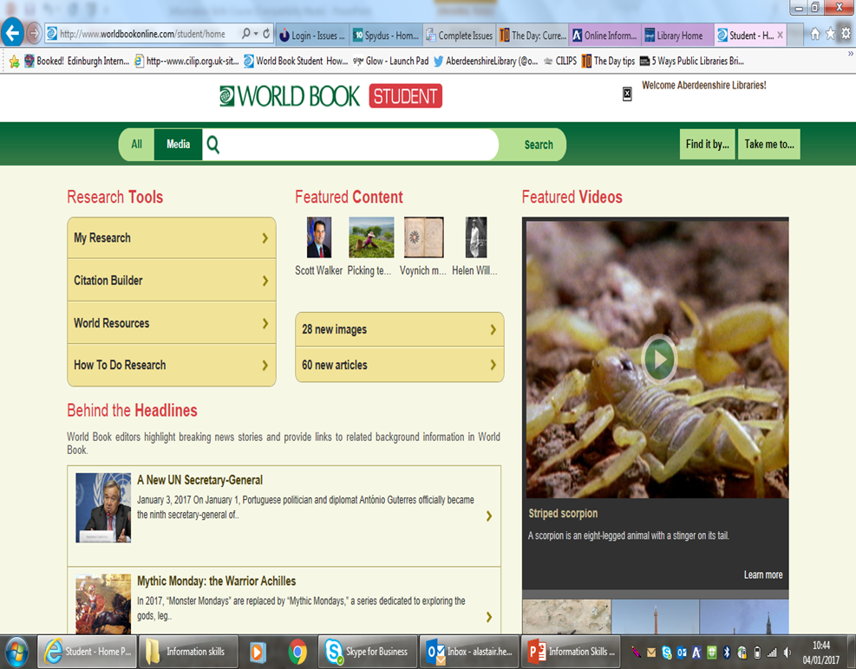
Internet & Database searching
Database: A collection of records stored on a computer or computer system.
The secret to a successful search is to use ‘keywords’.
These are significant words taken from your research question.

Slide 13
Searching Online
Domain names
Clues to types of website are found in domain names.
.com= commercial site
.gov= government site
.org= organisation (non-commercial)
.ac= university
.net= network service provider, Internet admin site
International sites
Sites based in a particular country often have two letters after the name of the site, e.g. ‘www.asthma.org.uk’.
cn= China
jp= Japan
fr= France
de= Germany
Searching
Look at the heading and basic summaries
Copy/ bookmark the URL or Web address, to revisit and reference.
Use quotation marks when searching for phrases or groups of words, for example: “history hula hoops”
“rio de janeiro”
Do not include words such as “the”, “and”, “or”, “of”.

Slide 14
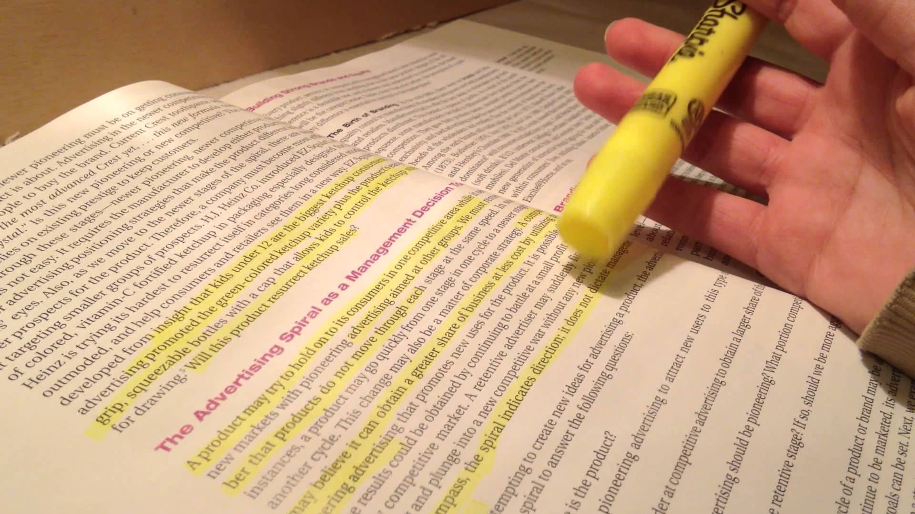
Reading for Information
Skimming Read first and last paragraphs quickly to get a summary of the topic (newspaper/ film review reading)
Scanning Each line, middle of the page, looking for your keywords.
Keywords Relevant words to the subject being studied, e.g. ‘Rainforest’ (tropical, rainfall, forestation, humidity) names, places, dates.
Extract keywords from your question and your ‘mind map’ then highlight/ underline relevant words or passages.

Slide 15
Note-taking
Why take notes?
Remember what you’ve learned.
Ensure you understand what you’ve written.
Keep track of information (for your bibliography).
Avoids Plagiarism.
Shows how hard you’ve worked!
Format:
Short/ Concise
Bullet points
Quotes
Organised (by colour in a Word doc?)
Fact cards

Slide 16
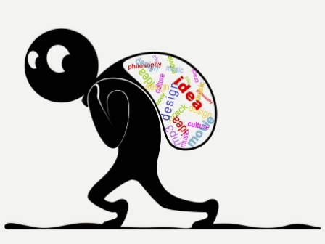
Plagiarism
Copying someone else’s work and passing it off as your own.
Copying straight from books.
Copy and Pasting from the internet.
Your teacher wants to hear what YOU know and what YOU think.
You wouldn’t steal someone else’s things or answers in an exams so why would you steal their thoughts?
Plagiarism is NOT the use of common facts that everyone knows:
Common known fact: The River Amazon in South America is the largest river in the world by volume.
Fact taken from a source: At the mouth of the River Amazon, 4.2 million cubic feet of water empties into the ocean per second. (Taken from “How Great is the Amazon River” http://www.extremescience.com/amazon-river.htm

Slide 17
Avoiding Plagiarism
Take careful notes:
Write down where you read something and what page it was on.
Write your notes as you read.
Give credit where it is due:
If you agree with something in a book, you can use a phrase such as: “As Jane Austen says…” This lets the teacher know who the thoughts belong to.
When writing your bibliography and footnotes, include more than is strictly necessary.
Use quotation marks:
If directly quoting from a source, use quotation marks.
Make sure the quote includes the information about where you took it from.
Quotations can save your word count!
Protect yourself:
Be sure to give yourself enough time to complete your project, that way you won’t be tempted to take shortcuts.
Keep drafts of your papers- sometimes a researcher can be unfairly accused of plagiarising. If you have copies of your notes, you can prove that the thoughts are your own.

Slide 18
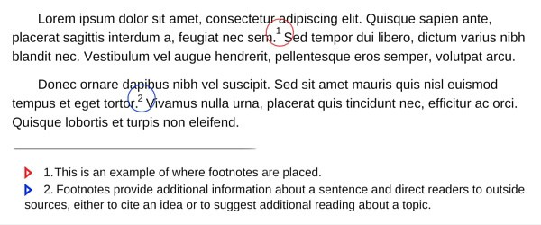
Footnotes

Slide 19
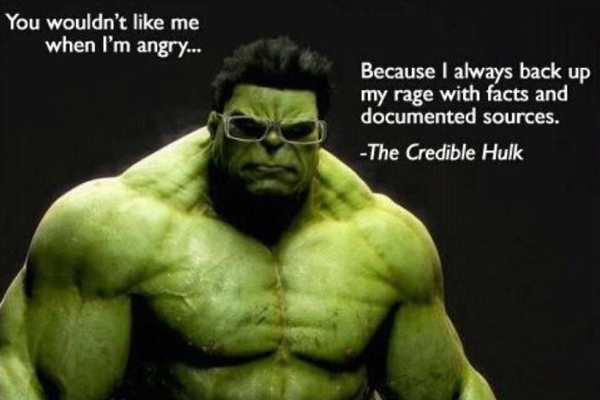

Slide 20
Quoting
Direct Quotation
“The Troubles are rooted in the split between the Protestant and Catholic communities” (Allan, 2004)
Paraphrasing
Restatements of information put into your own words.
Text:
“The Troubles are rooted in the split between the Protestant and Catholic communities, which can be traced back at least four hundred years.”
Paraphrased text:
Allan (2004, p27) identifies the split between Protestants and Catholics as traced back four hundred years. (Allan, 2004)
Summarise
A summary combines information into fewer words.
Text:
“Following an unsuccessful rebellion against British rule, Scottish Protestant settlers were deliberately moved to Ireland on the orders of the British King. They were ‘planted’, or settled in Ulster, the region where the rebellion had been centred.”
Summarised text:
The British King moved Scottish Protestant settlers to Ulster, a region of Ireland. (Allan, 2004)
Text taken from ‘The Troubles in Northern Ireland’ by Tony Allan, Heinemann Library, 2004.

Slide 21
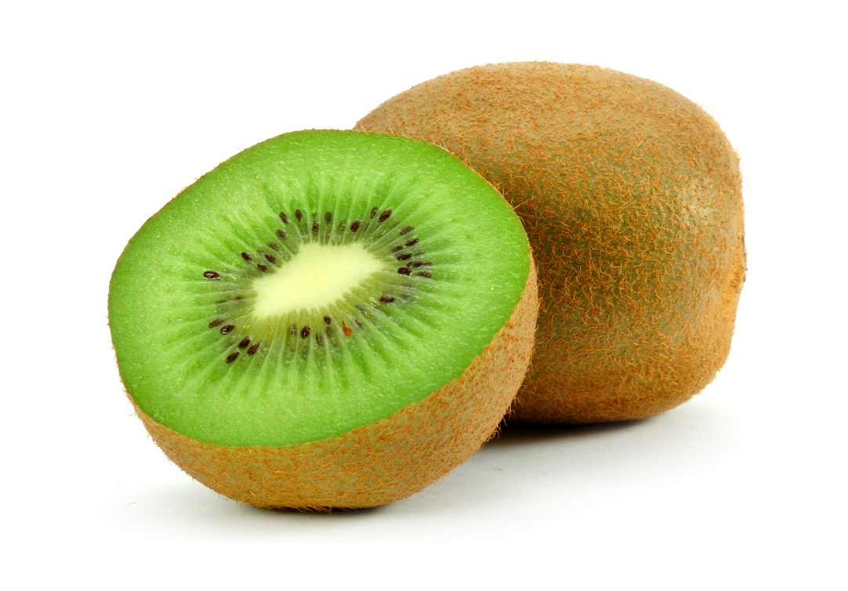
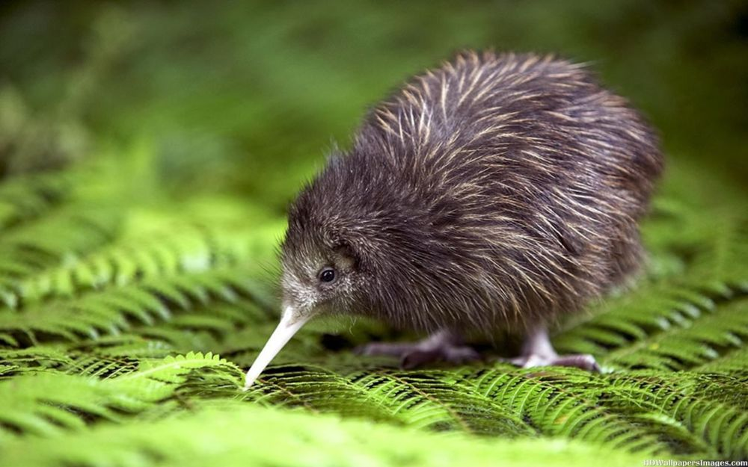
C.A.R.
Current When was the source created/ website updated? Is the information up-to-date?
Accurate Who is the author? Credentials? From a reputable organisation? Could they be unreliable or biased?
Relevant Does the source really answer your key question? Is it too easy/ hard/ about right? Too much/ not enough detail?
This?
Or this?
Challenge what you are reading and be critical!
Is the information related to your topic?
Is it important enough to include?

Slide 22
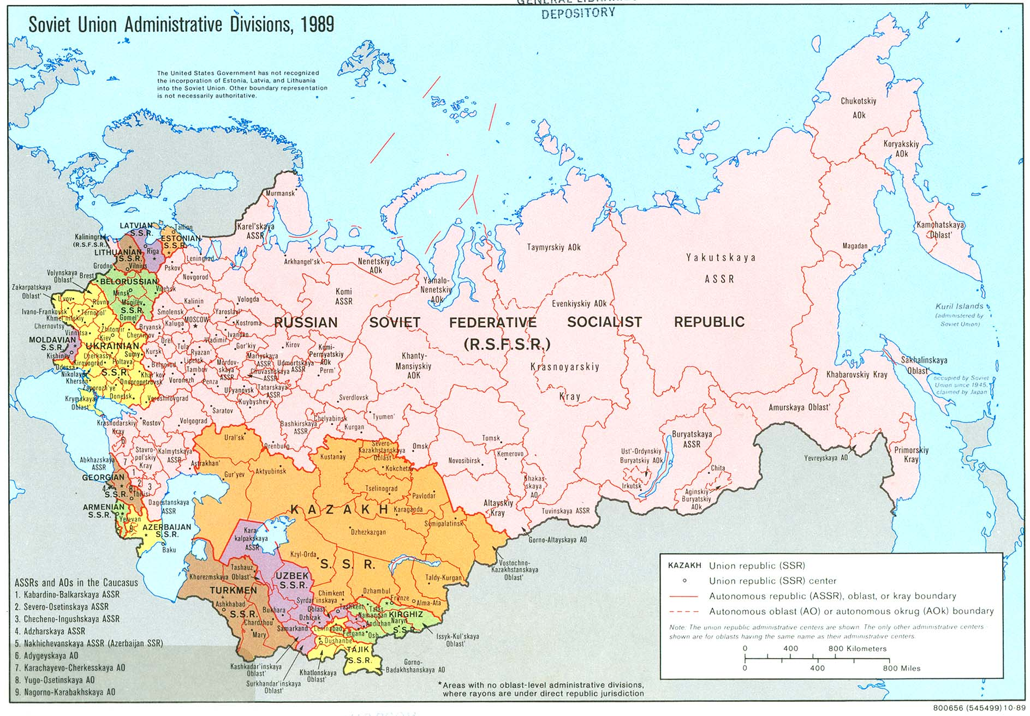
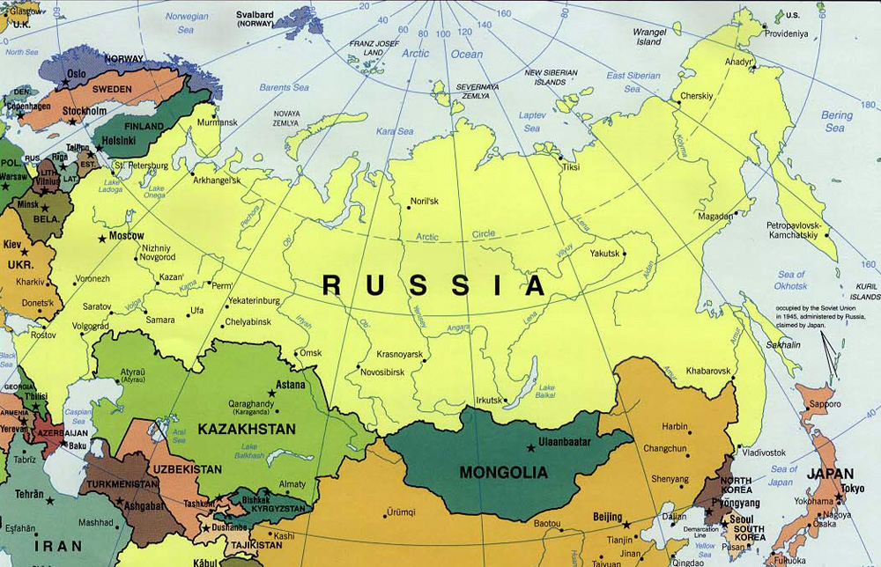
Spot the difference?
Dates are important!

Slide 23
Facts, Opinions and Points of View
-Many facts are common knowledge.
-Many other facts have to be verified.
-Why is a person writing on a topic?
do they have something to gain?
-What they write may not be impartial.
Freezing temperature of water: a fact that only needs one source to confirm.
Each of these sources will provide a different take on ‘Global Warming’:
A leading Scientific Research Council
A personal blog from a climate change protestor.
A company offering Carbon-neutral flights.

Slide 24
Bias
Advertisements
Contains bias as they are selling a product. Sometimes adverts are disguised as articles.
Political statements
Contains bias as they are trying to convince others of an opinion.
Scientific research
Supposed to be objective but results can be influenced by the researcher’s opinion.
UK-centric
Topical issues, History or News presented from a UK-centred point-of-view.
Are these the best people to ask about their candidate’s appeal?

Slide 25
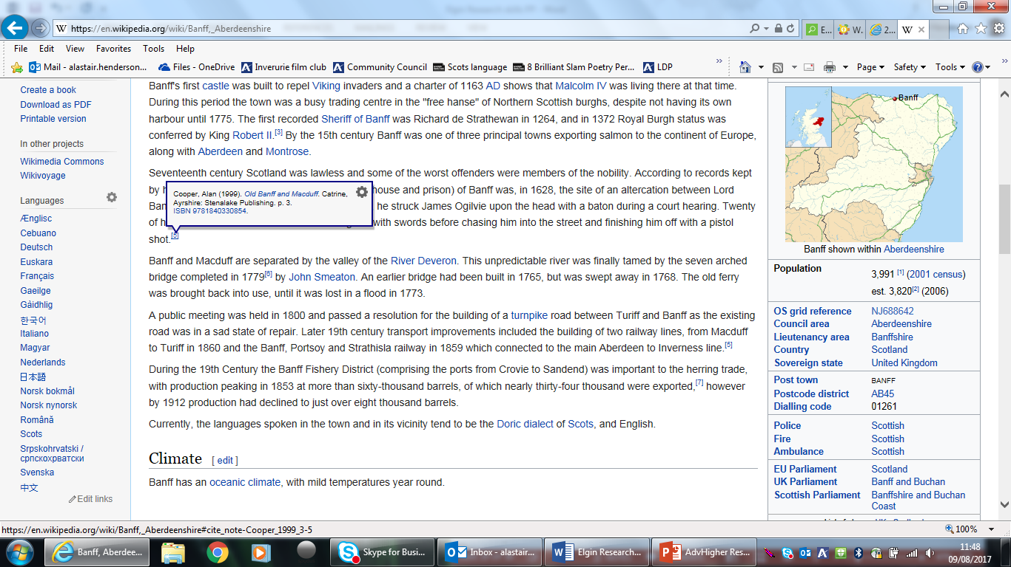
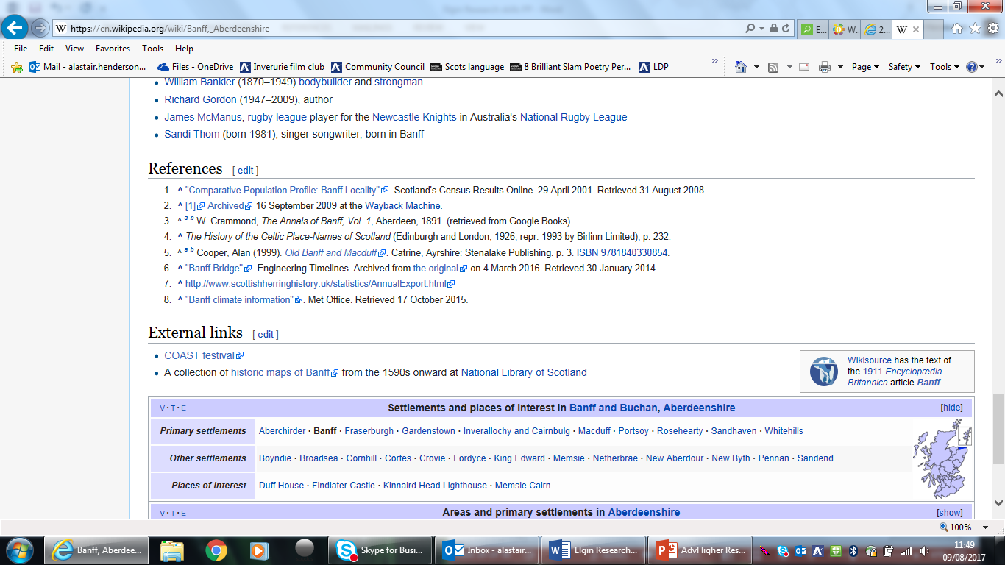
Using Wikipedia as a starting point
“The free encyclopedia that anyone can edit” (Wikipedia, 2009)
Wikipedia can be an excellent starting point for research- an overview.
Anyone can add information- even you!
The information may not be authoritative or accurate- in some cases, completely untrue!
Check the reference list for the article
Carry out further research to find the referenced articles.
Use the ‘history’ and ‘discussion’ pages to help evaluate the information.
Never use Wikipedia as your only source.

Slide 26
Keeping track of your sources
Type of source
Author(s) (if known)
Title or URL
Publisher, place and date of publication
Date you used the source
Book
Catherine Burch
Food (Growing up in World War 2).
Franklin Watts, London, 2005
5 April, 2010
Person (interview)
James Smith
Interview with my granddad about his experiences of rationing in World War 2.
6 April, 2010
Television programme
What we ate in the war.
BBC2, 2005
8 April, 2010
Website
Food and shopping – World War 2.
http://cookit.e2bn.org/historycookbook/20-97-world-war-2-Food-facts.html
BBC
2 April, 2010
Notes:
Taking good notes saves a lot of time and backtracking later if you don’t remember which book or website the information comes from.
Tips:
Use the back page of your jotter, note cards, open a blank word document on your PC, whatever works for you!
You can use a grid like the one here to help you keep track.

Slide 27
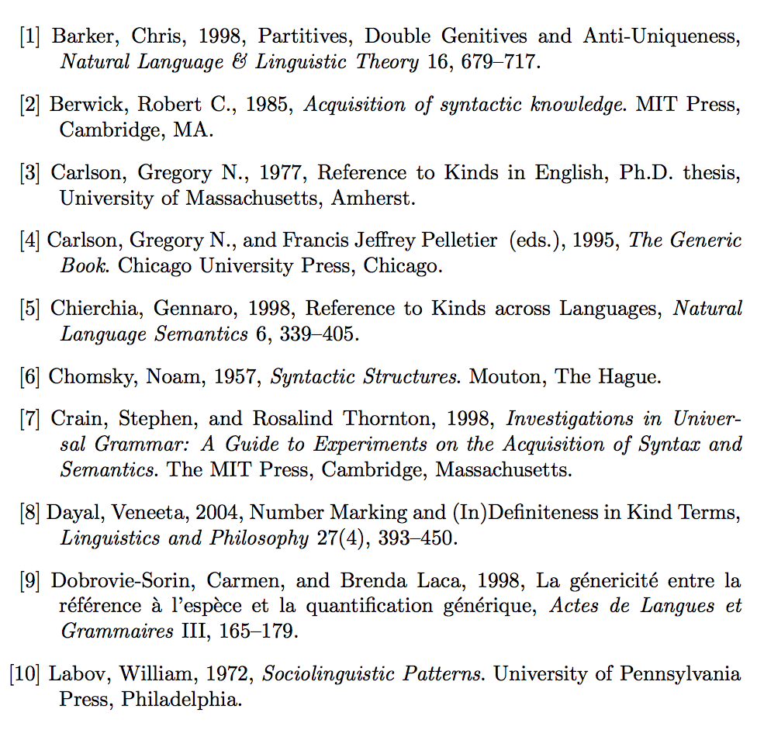
Bibliography: A list of References, Sources and works cited

Slide 28
NEVILLE, C. (2010) The Complete Guide to Referencing and Avoiding Plagiarism. 2nd Ed. Maidenhead: Open University Press.
In text:
Neville (2010) argues that…
“Quotation” (Neville, 2010, p.76)
BRADBURY, I., BOYLE, J. and MORSE, A. (2002) Scientific Principles for Physical Geographers. Harlow: Prentice Hall.
CAMPBELL, N. A. et al (2008) Biology. 8th Ed. London: Pearson.
Notes:
Sources need to be acknowledged when you are writing your project.
This allows your teacher to
Check your work
See which sources of information you have used
Ensure you haven’t just made up the information
Some web pages don’t make it clear who produces them. This should be a reason not to use the information on those pages! Always use quality web pages (which will always have publication details, usually near the bottom of the home-page).
When we make this list, we are “referencing” our sources. The list itself is called the “References,” or sometimes it is called the “Bibliography.” A ‘Bibliography’ is a list of sources used to produce a piece of work – a report, an essay, a presentation. It should include all the sources you have consulted.
Your list of reference goes at the end of your project, investigation or piece of writing.
It is very important to keep a note of where you found your information so that you are not accused of plagiarism, i.e. using another author’s work without permission or acknowledging it.
This is an example of HARVARD referencing of BOOKS, if more than 3 authors are involved, just name one + ‘et al’.

Slide 29
WILSON, J. (1995) Enter the Cyberpunk Librarian: Future directions in Cyberspace. Library Review. [Online] Emerald Database 44 (8). p.63-72. Available from: http://www.emeraldinsight.com. [Accessed: 30th January 2012].
BBC NEWS. (2008) Factory gloom worst since 1980. [Online] Available from: http://news.bbc.co.uk/1/hi/business/7681569.stm. [Accessed: 19th June 2012].
Notes:
JOURNALS
Author in capitals
Title of the journal italicised
Online/ accessed in square brackets
Journal volume, part number or month in brackets, followed by page numbers
WEBSITE
Website name (if no author available)
Article in italics
Date accessed in square brackets

Slide 30
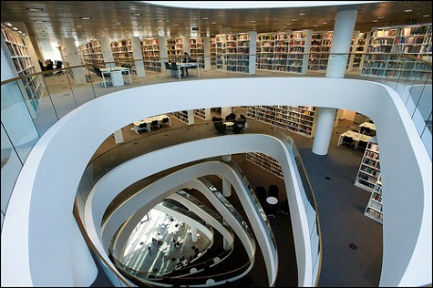
University Libraries
The Uni Library Dewey System classifies knowledge by discipline not subject- we simplify things in the school library.
School Library is organised by ‘subject’
University Library is organised by ‘discipline’
What’s the difference?
-Discipline refers to a branch of academic study.
-Subject refers to a branch of knowledge studied or taught.
In schools, you learn a number of subjects such as mathematics, science, language, history, religion, music, art, sport, etc.
Psychology, Sociology, Anthropology, Mathematics and Philosophy are all disciplines.
Mathematics is a school subject that is also a discipline.

Slide 31
SUBJECTS

Slide 32
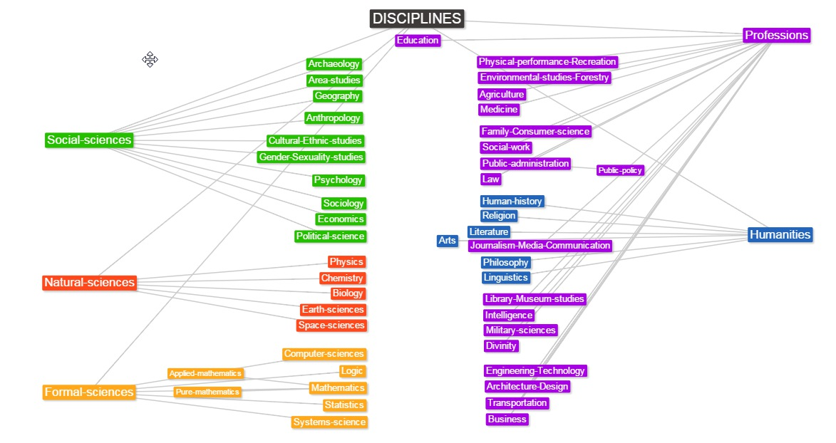

Slide 33
This is the Dewey class number used in the school library:
The Weimar Republic= 943.085
Within: History—Germany—20th Century
However a catalogue search in a University Library could include numbers like these:
305.55609430904
‘Salaried masses: duty and distractionism in Weimar Germany’
332.41094309042
‘Culture and Inflation in Weimar Germany’
362.19685280094315
‘Berlin Electropolis: Shock, nerves and German modernity’
…so ‘Social History’, ‘Politics’, ‘Economics’, even though they describe events during the period of the Weimar Republic, are classified under the main division of:
Social Science 300-399

Slide 34
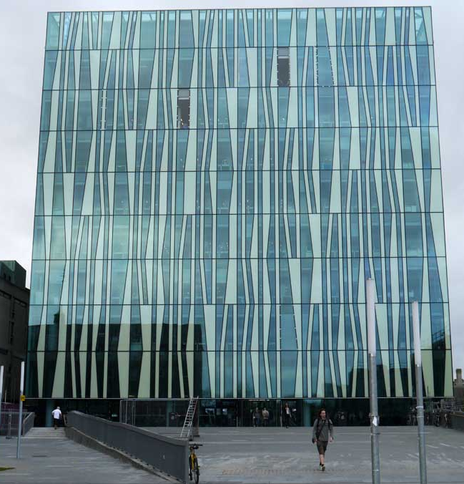
Non-Student University Library Access
Teachers and S6 pupils only
No assistance from staff
Inform School Librarian= book in advance
Photo ID required
Access e-Catalogue before arrival/ identify what you want
Walk-in Service
E-journals
Terms and Conditions (10 mins.)
Bring a memory stick
Dedicated terminals
Copying? (1 chapter per book, 1 article per journal)

Slide 35
Slides adapted from: ‘Information Skills’ series
by B. Pulver and D. Adcock (2009)

